Slide 1
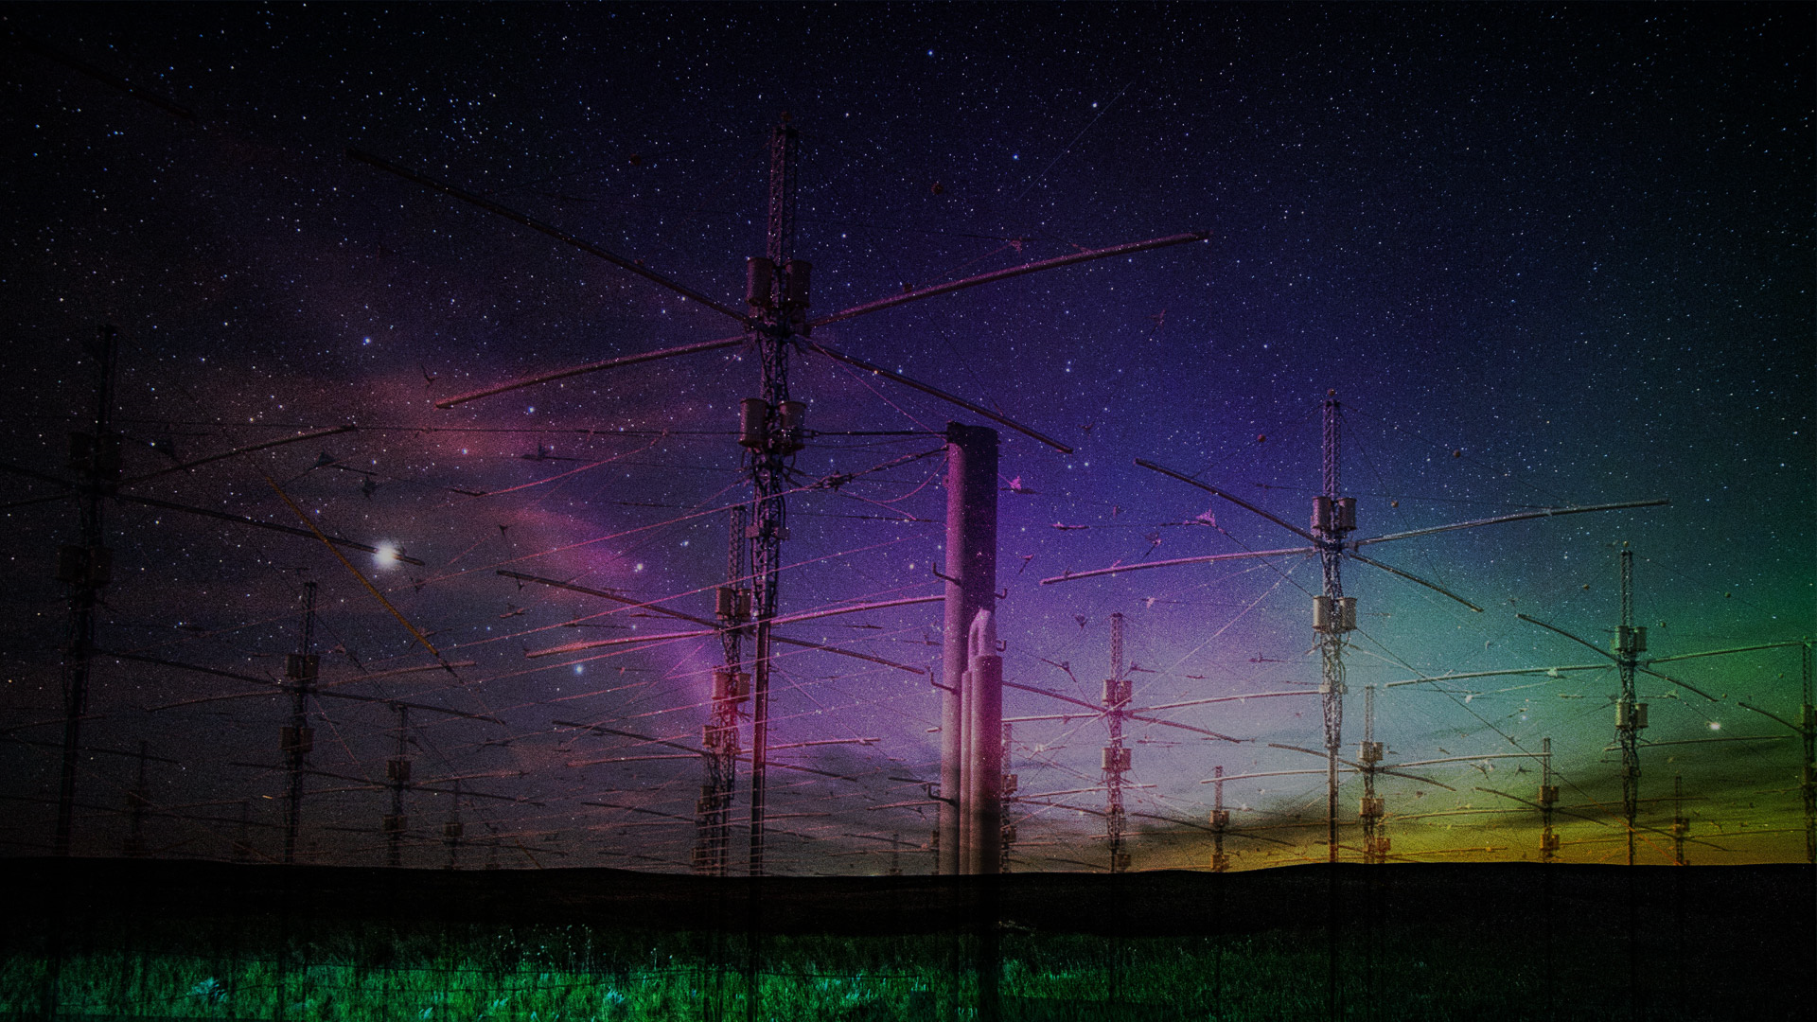
Ionospheric
HEATERS
SPACE WEATHER CONTROL
AND
GEOPHYSICAL WARFARE
By Jim Lee of ClimateViewer.com and WeatherModificationHistory.com ^{November 14, 2018}
Notes:
HAARP and the Sky Heaters
https://climateviewer.com/haarp/
BACKGROUND IMAGE:
Mystery of Purple Lights in Sky Solved With Help From Citizen Scientists
http://blog.aurorasaurus.org/?p=557
7 Things to Know about “STEVE”
http://blog.aurorasaurus.org/?p=449
Spacequakes Rumble Near Earth
https://science.nasa.gov/science-news/science-at-nasa/2010/27jul_spacequakes

Slide 2
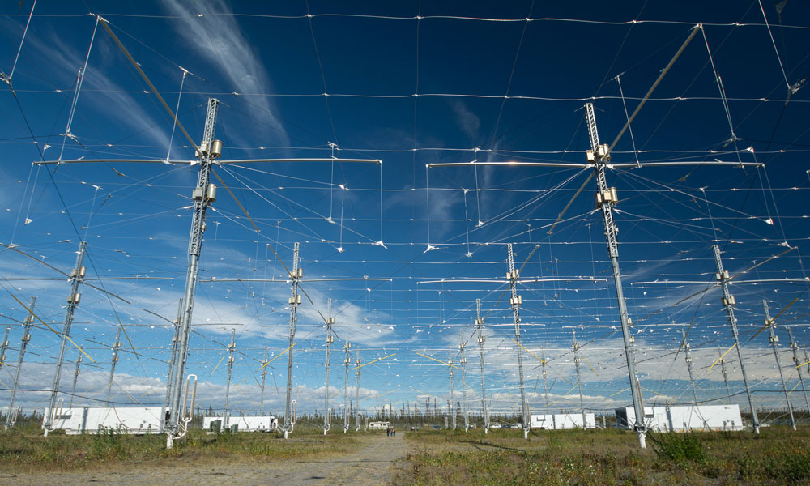
What is an Ionospheric Heater?
“Powerful high frequency (HF) transmitter (2 to ­10 MHz) that induces controlled temporary modification to the electron temperature at desired altitude”
Notes:
https://climateviewer.com/haarp/

Slide 3
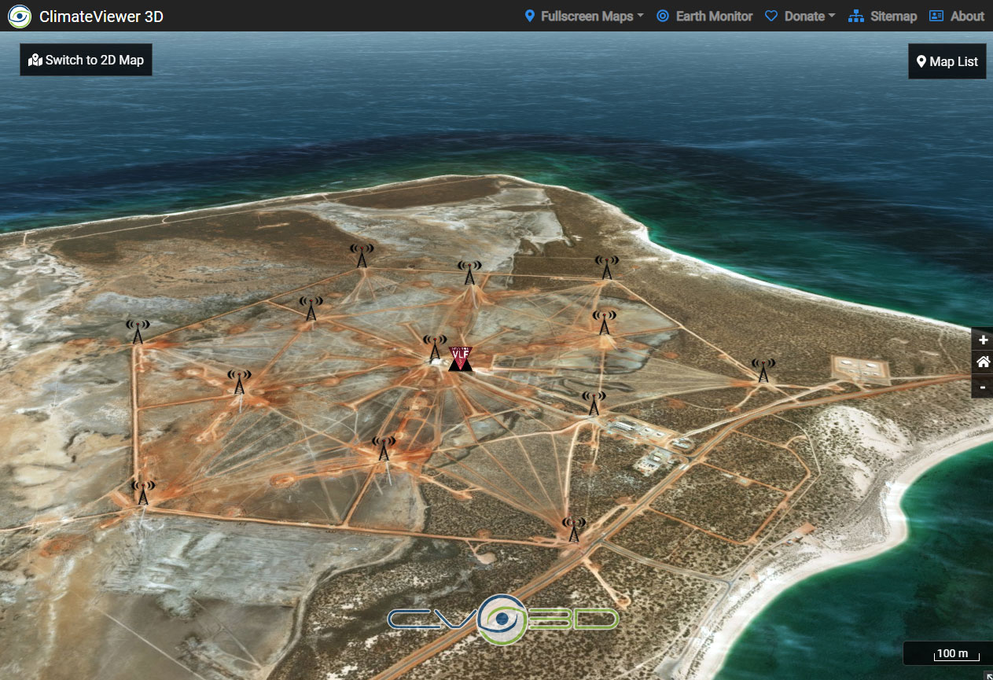
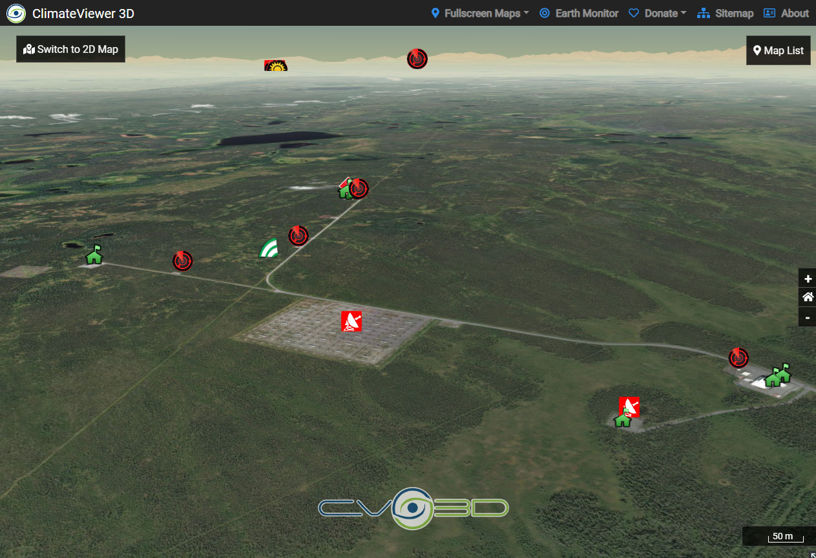
What is an Ionospheric Heater?
Harold E. Holt Naval Station - North West Cape, Exmouth, Australia - Frequency: 19.8 kHz at 2,000,000 Watts
DIRECTLY TRANSMITS VERY LOW FREQUENCY (VLF) - IS NOT AN IONOSPHERIC HEATER
High Frequency Active Auroral Research Program (HAARP)- Frequency: 2-10 MHz at 3,600,000 Watts
USES IONOSPHERE TO CREATE EXTREMELY LOW FREQUENCY (ELF) - IS AN IONOSPHERIC HEATER
Notes:
https://climateviewer.com/haarp/

Slide 4
Notes:
http://climateviewer.org/pollution-and-privacy/atmospheric-sensors-and-emf-sites/maps/haarp-ionospheric-heaters-worldwide/

Slide 5
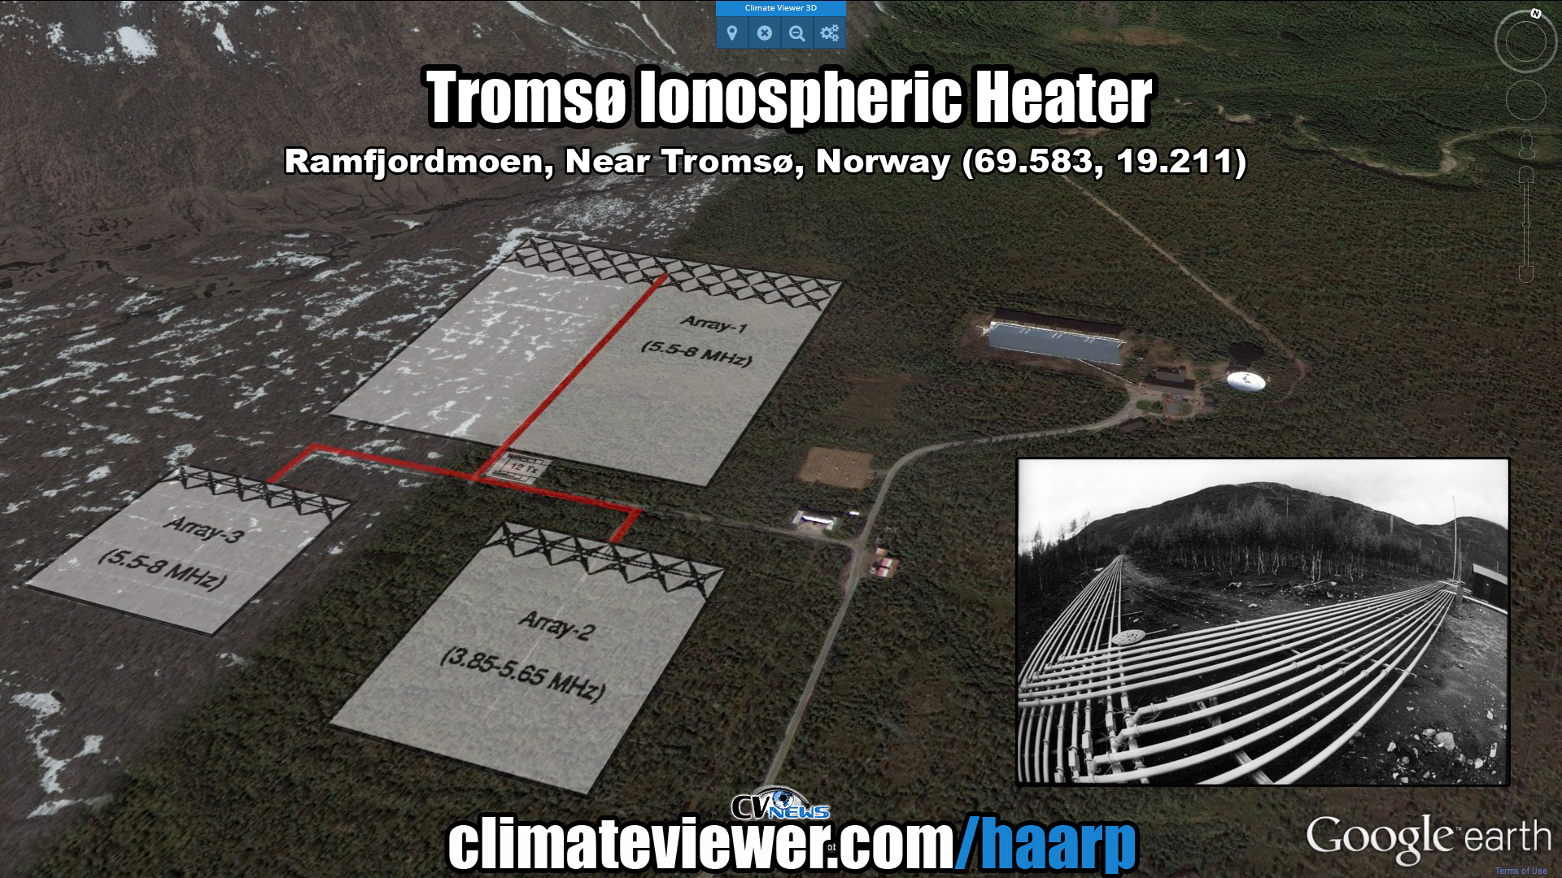
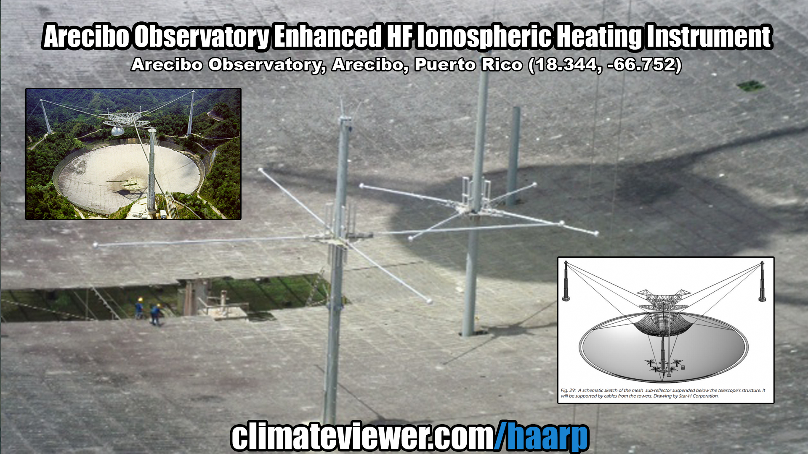
Top Four Ionospheric Heaters
Notes:
https://climateviewer.com/2014/10/18/ionospheric-heaters-how-haarp-really-works/

Slide 6
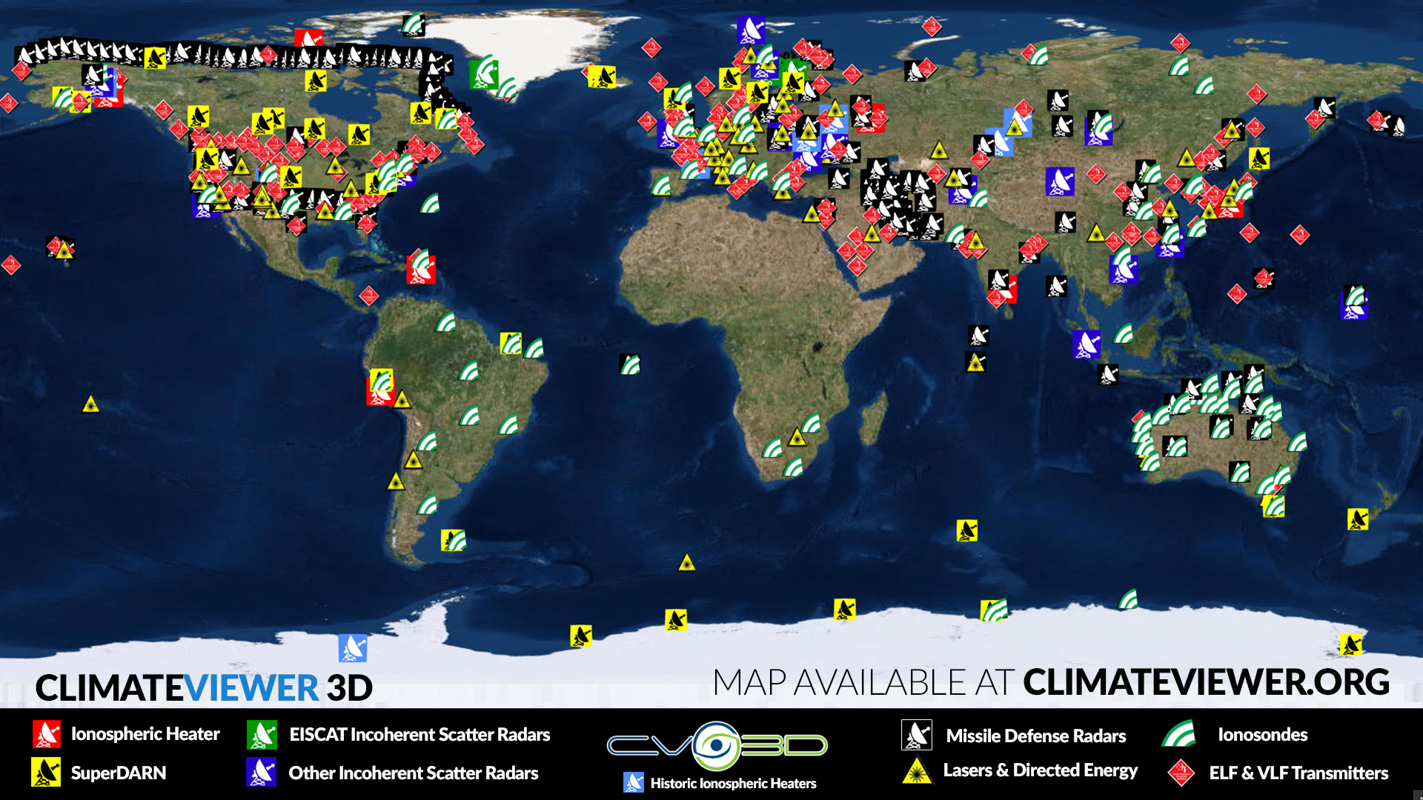
Notes:
http://climateviewer.org/pollution-and-privacy/atmospheric-sensors-and-emf-sites/maps/high-frequency-active-auroral-research-program-haarp/
http://climateviewer.org/pollution-and-privacy/atmospheric-sensors-and-emf-sites/maps/haarp-ionospheric-heaters-worldwide/
http://climateviewer.org/pollution-and-privacy/atmospheric-sensors-and-emf-sites/maps/missile-defense-radars-star-wars-space-fence/
http://climateviewer.org/pollution-and-privacy/atmospheric-sensors-and-emf-sites/maps/super-dual-auroral-radar-network-superdarn/
http://climateviewer.org/pollution-and-privacy/atmospheric-sensors-and-emf-sites/maps/digisonde-ionosonde-network/
http://climateviewer.org/pollution-and-privacy/atmospheric-sensors-and-emf-sites/maps/extremely-low-frequency-elf-ulf-vlf-transmission-sites/
http://climateviewer.org/pollution-and-privacy/atmospheric-sensors-and-emf-sites/maps/directed-energy-lasers-gravitional-wave-detectors-particle-colliders/

Slide 7
Why Heat the Ionosphere?
To use the sky as a “Laboratory without Walls” ^{Watch video:}
Converting the Ionosphere into a Laboratory without Walls - Active Ionospheric Research with HAARP
Notes:
https://climateviewer.com/haarp/
VIDEO: https://ams.confex.com/ams/98Annual/videogateway.cgi/id/43414?recordingid=43414&uniqueid=Paper327700&entry_password=479531
https://ams.confex.com/recording/ams/98Annual/mp4/free/4db77adf5df9fff0d3caf5cafe28f496/paper327700_1.mp4
https://ams.confex.com/ams/98Annual/webprogram/Paper327700.html
Converting the Ionosphere into a Laboratory without Walls—Active Ionospheric Research with HAARP
Monday, 8 January 2018: 3:15 PM
Salon J (Hilton) (Austin, Texas)
Robert P. McCoy, Univ. of Alaska, Fairbanks, AK; and C. Fallen and B. Bristow
Active ionospheric experimentation using high power HF transmitters has an enormous potential to explore a wide range of plasma science in the upper atmosphere, ionosphere, and magnetosphere. Distinct from conventional ionospheric remote sensing or in-situ measurement, active ionospheric “heating” temporarily modifies a small region overhead to observe how it relaxes back to its quiescent state. By modulating the HF frequency and amplitude, the ionosphere can be used as an antenna to generate low frequency waves (ULF, ELF, VLF, Whistler, etc.) and inject them into the earth-atmosphere waveguide or up along magnetic field lines into the magnetosphere. Selected frequencies of high power HF energy can create optical emissions and drive a wide array of plasma instabilities, irregularities and turbulence. Active heating facilities can address science and applications in radio science, mesosphere and thermosphere science, space weather, magnetospheric and radiation belt science. These facilities can be used to address a range of applications including communication and navigation, over-the-horizon radar, and radiation belt effects on space systems.
With a capability to radiate 3.6 MW net power, High frequency Active Auroral Research Program (HAARP) is the most powerful ionospheric heater in the world. It has the widest selectable frequency range: 2.8MHz to 10MHz and is constructed as a phased array to form multiple beams that can be modulated and steered rapidly for the desired application. HAARP has been used to create artificial airglow, artificial ionospheric layers, instabilities, irregularities and turbulence and a wide range of low frequency waves. The Geophysical Institute of the University of Alaska Fairbanks (UAF/GI) recently took ownership of HAARP from the Air Force Research Laboratory, restored the facility to operational status. This past February the UAF/GI carried out a campaign with multiple experiments and multiple sponsors. A follow-on campaign is planned for this fall. The status of HAARP and a summary of recent experiments will be presented.

Slide 8
Why Heat the Ionosphere?
• Space Weather Control
• Terrestrial Weather Modification
• Climate Control (affect global temperature)
• Space Warfare (Anti-Satellite and ICBMs)
• Radiation Belt Remediation & Artificial Aurora
• Create Extremely & Ultra Low Frequency (ELF and ULF) Waves
• Signal the Apocalypse: Talking to Submarines
• Artificial Gravity Waves & Travelling Ionospheric Disturbances
• Mind Control (EMF Health Effects)
• Create Artificial Ionospheric Mirrors (reflect radio signals)
• Laser Developed Atmospheric Lens
• Probe Underground Structures
• Create Artificial Earthquakes?
Notes:
https://climateviewer.com/haarp/

Slide 9
Space Weather Control
DEFINITION: Scientific experiments to control conditions in the region of space close to the earth, especially the presence of electromagnetic radiation and charged particles emitted by the sun, that can affect human activity and technology

Slide 10
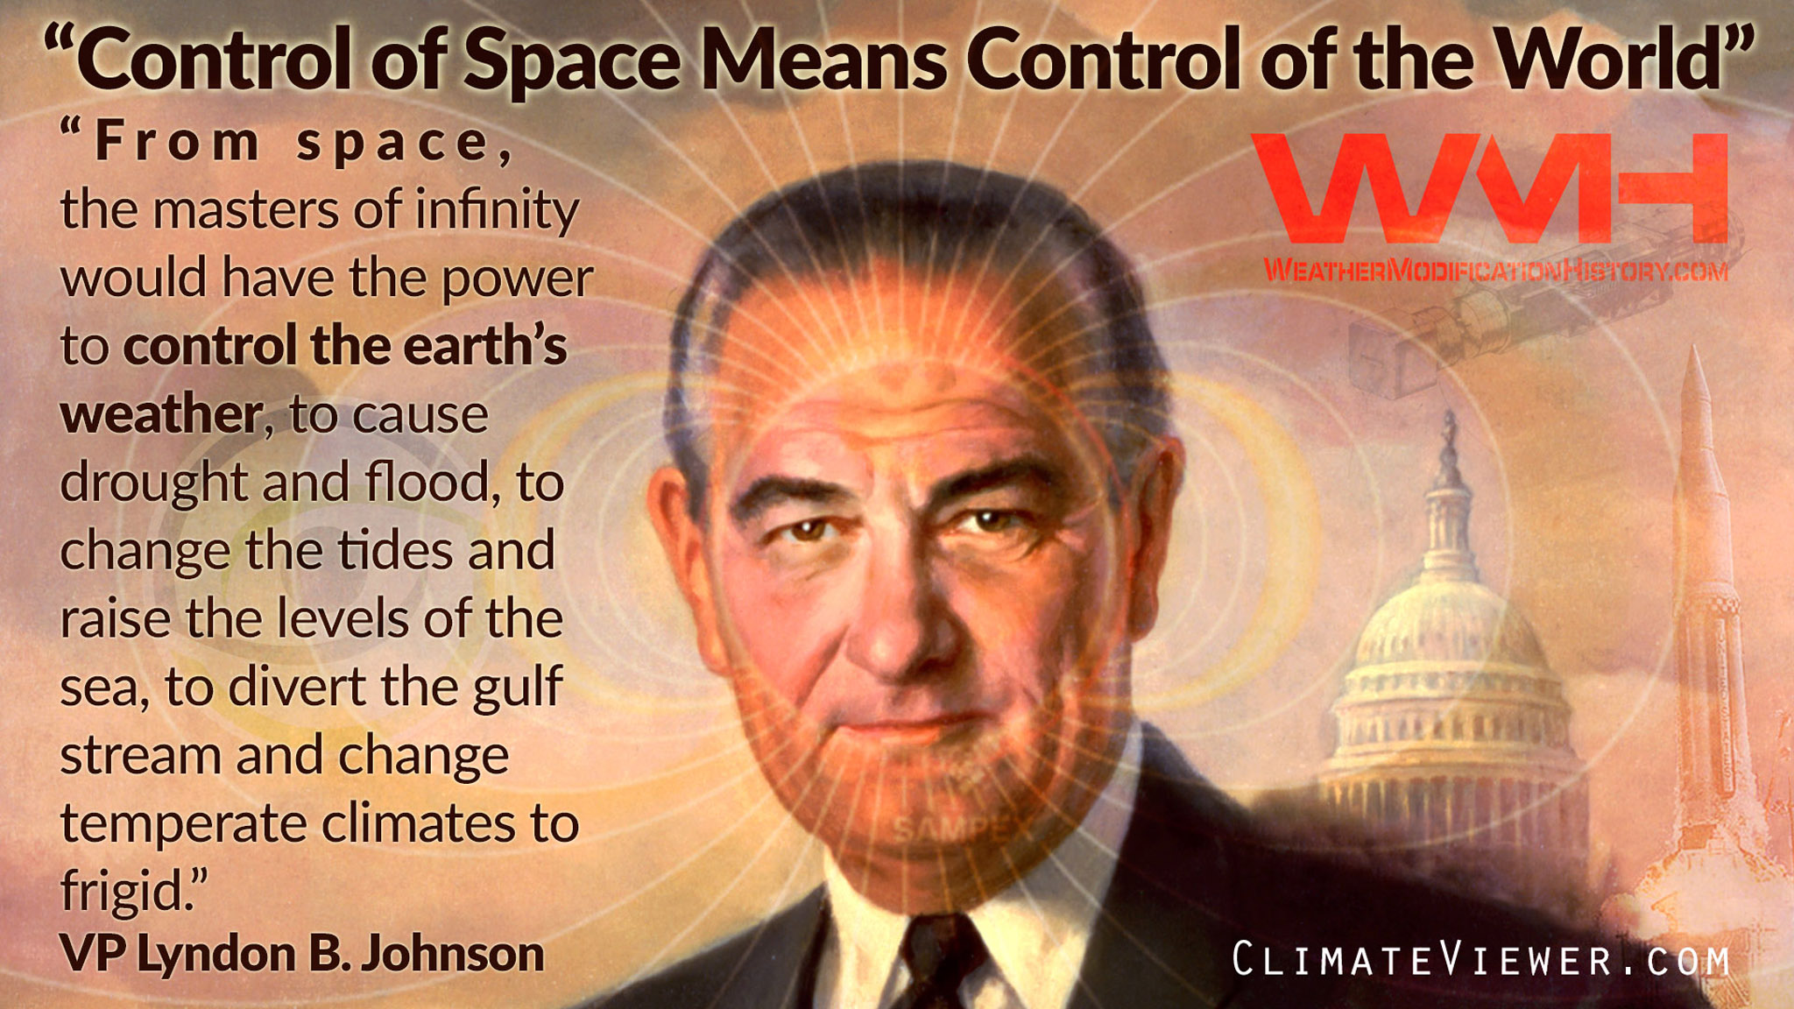
Notes:
https://weathermodificationhistory.com/president-lyndon-johnson-weather-wafare/

Slide 11
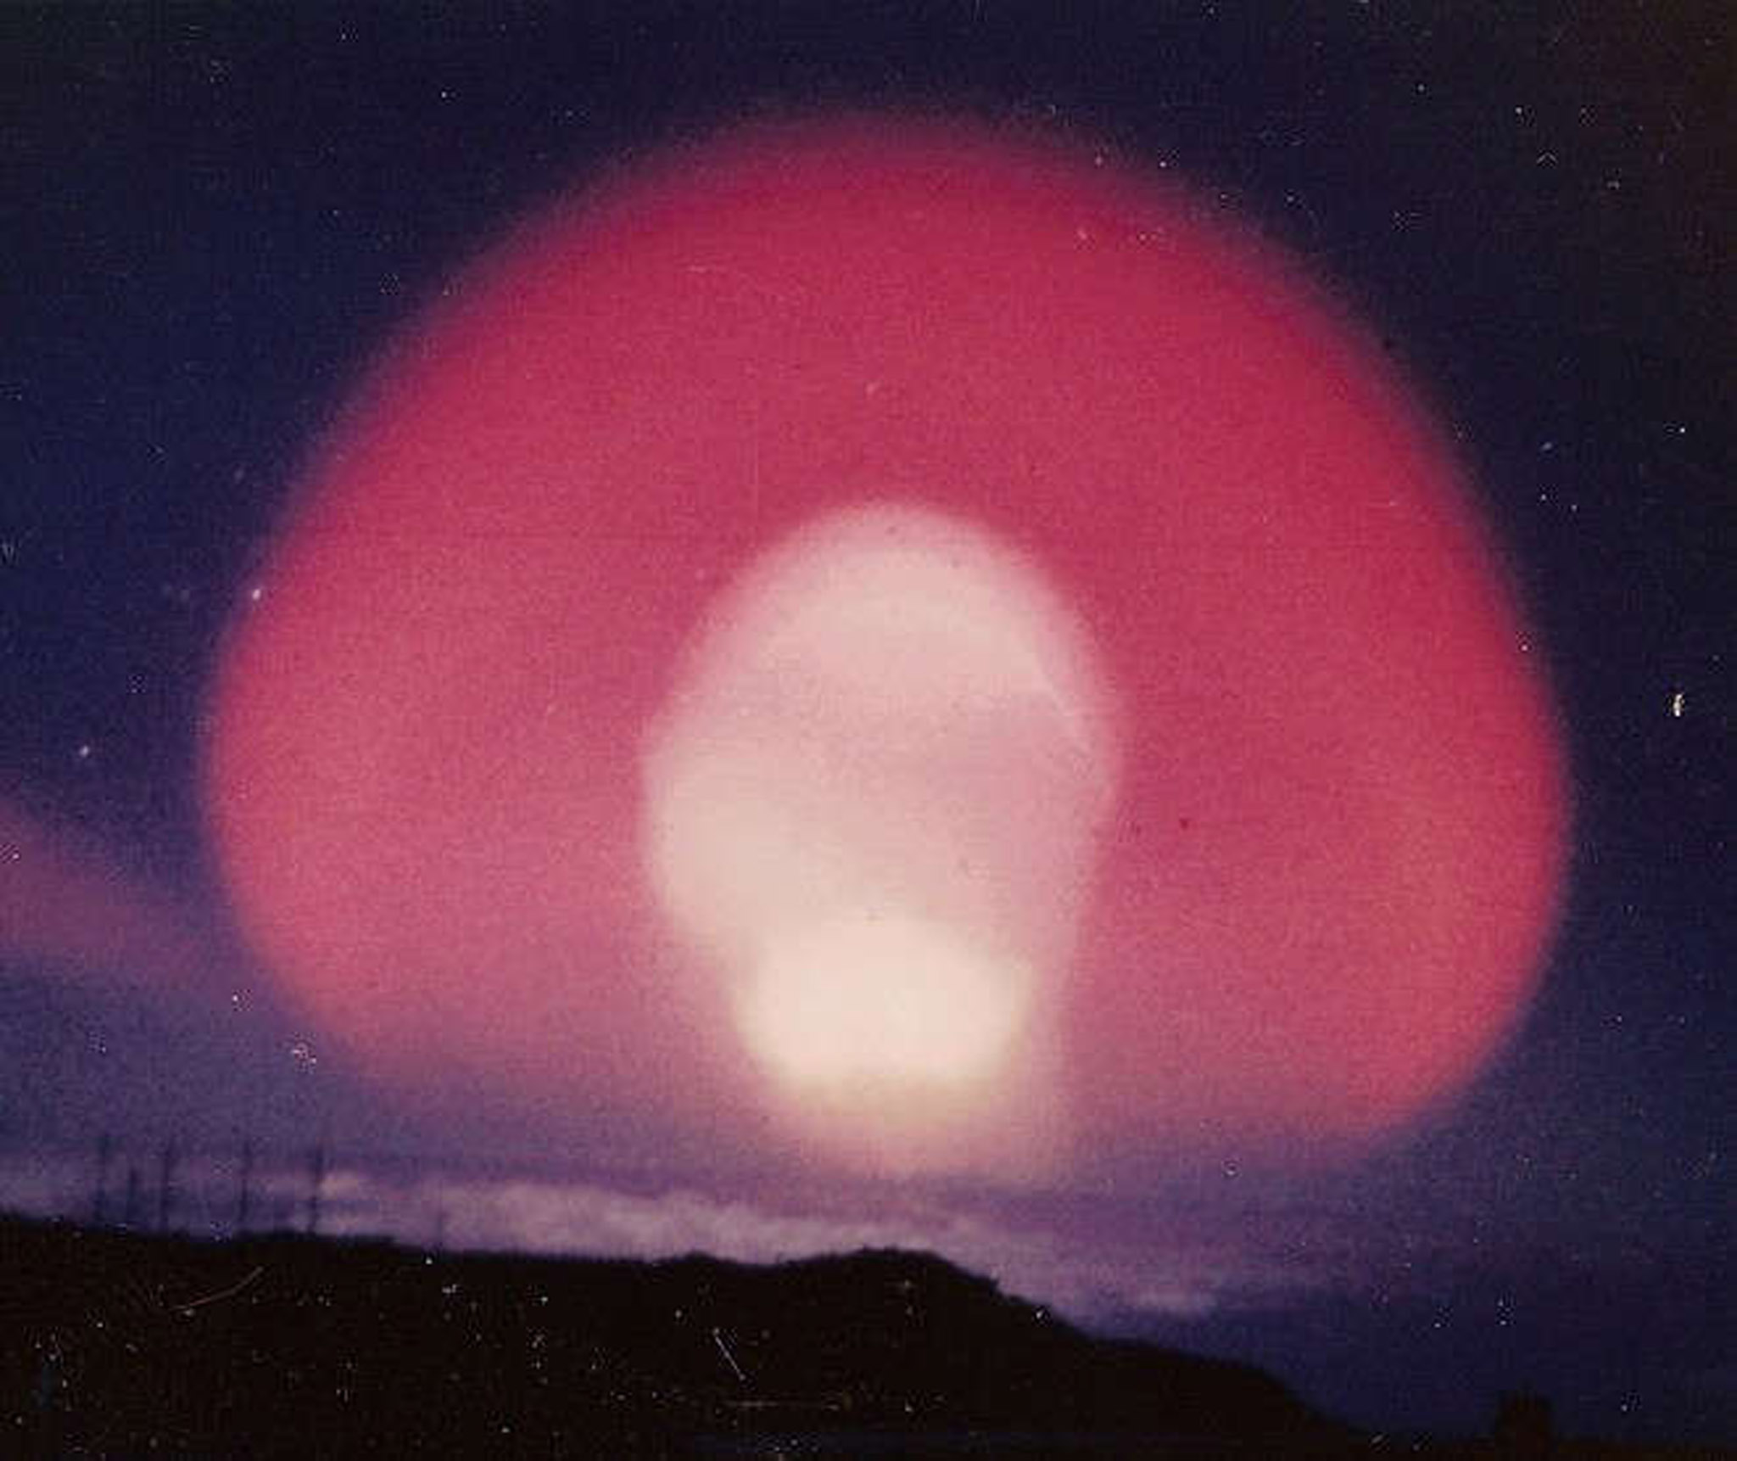
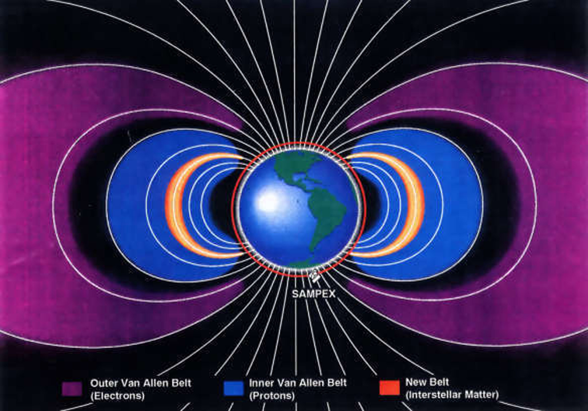
Space Weather Control (History)
Upper Atmospheric Nuclear Explosions
• Operation Argus (USA)
August 27 - September 6, 1958
• Operation Hardtack (USA)
August 1-12, 1958
• Starfish Prime (USA)
July 9, 1962
• Operation K (Russia)
October 22 - November 1, 1962
Notes:
https://weathermodificationhistory.com/limited-test-ban-treaty/

Slide 12
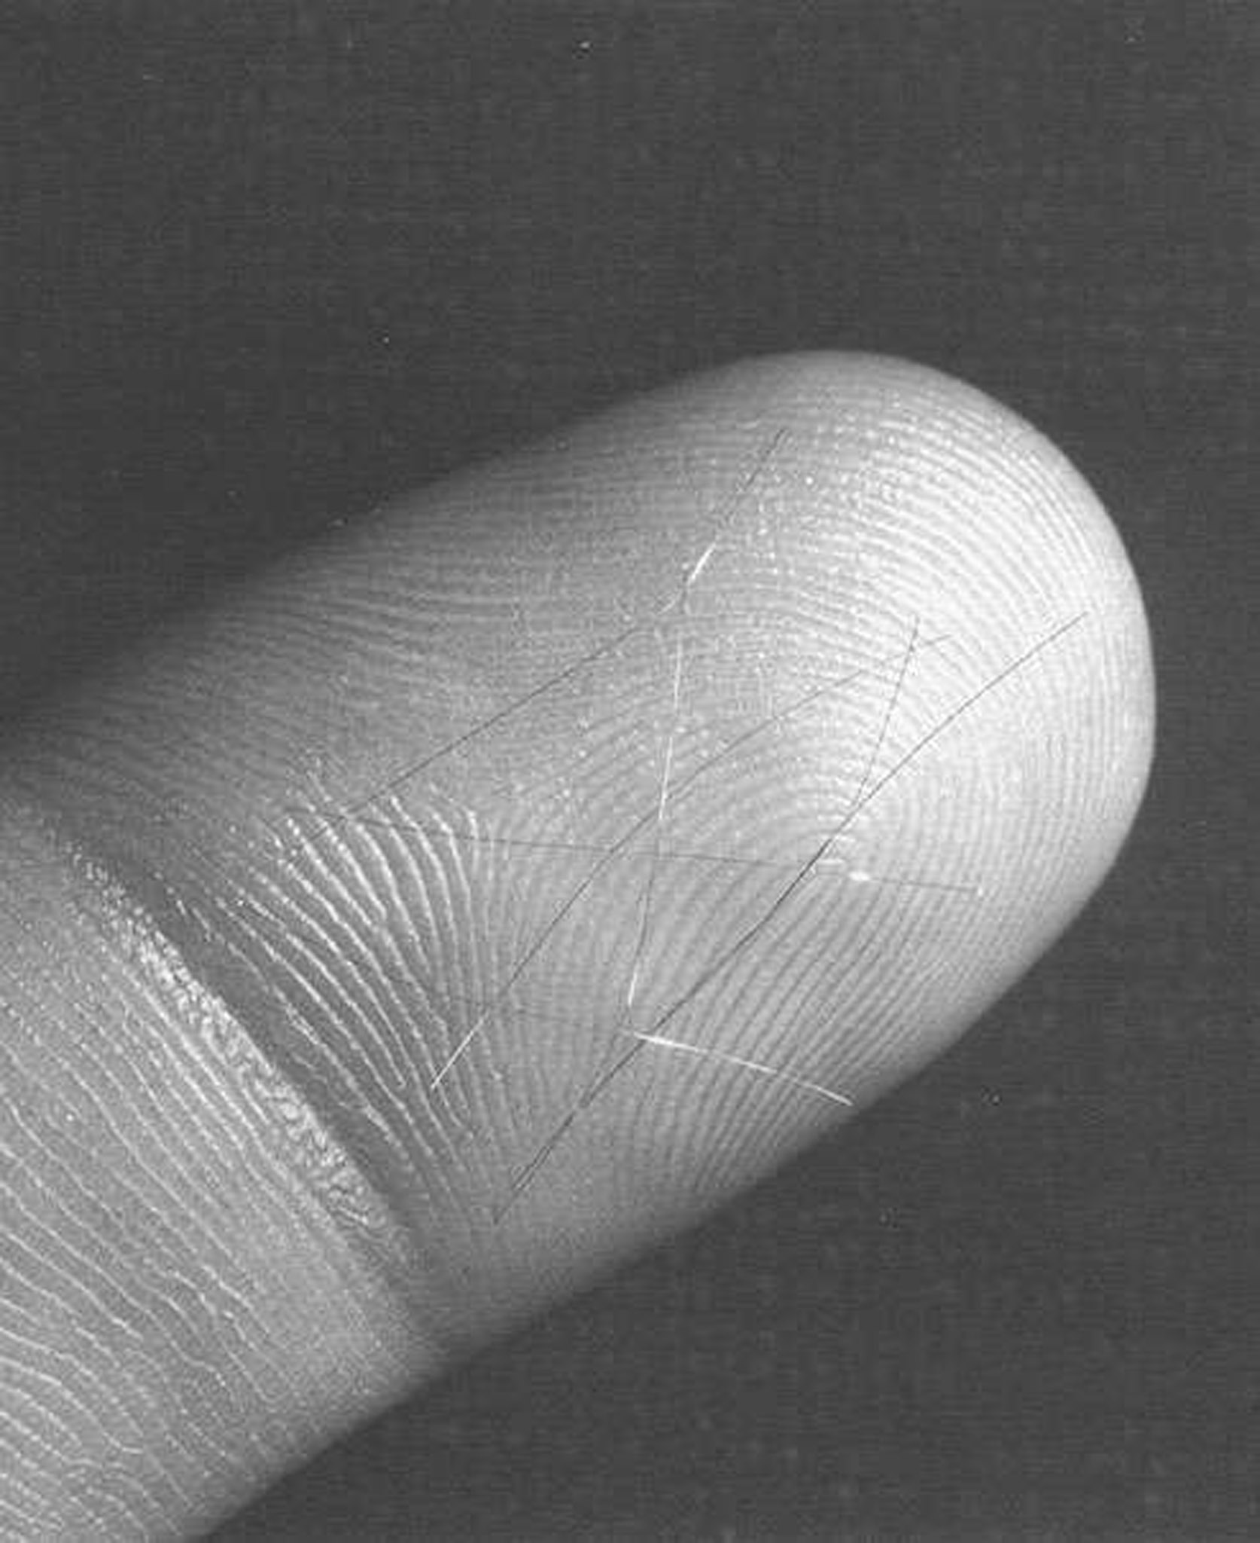
Space Weather Control (History)
Project West Ford (Needles) 1961-1963
480,000,000 copper dipole antennas launched into orbit.
The West Ford Needles project was an experiment to allow long distance communications by bouncing radio waves off of a band small wires (passive dipoles) cut to a specific length. In an attempt to lay a radio-reflective ring around the world, small metal dipole needs were allowed to sublimate out of a matrix.
Two experiments were conducted, one in 1961 and another in 1963. The 1961 experiment was not successful when the needles failed to sufficiently disperse. The 1963 experiment was successful. The nature of the West Ford-Drag payload is not clear.
Notes:
https://weathermodificationhistory.com/project-west-ford-space-needles/

Slide 13
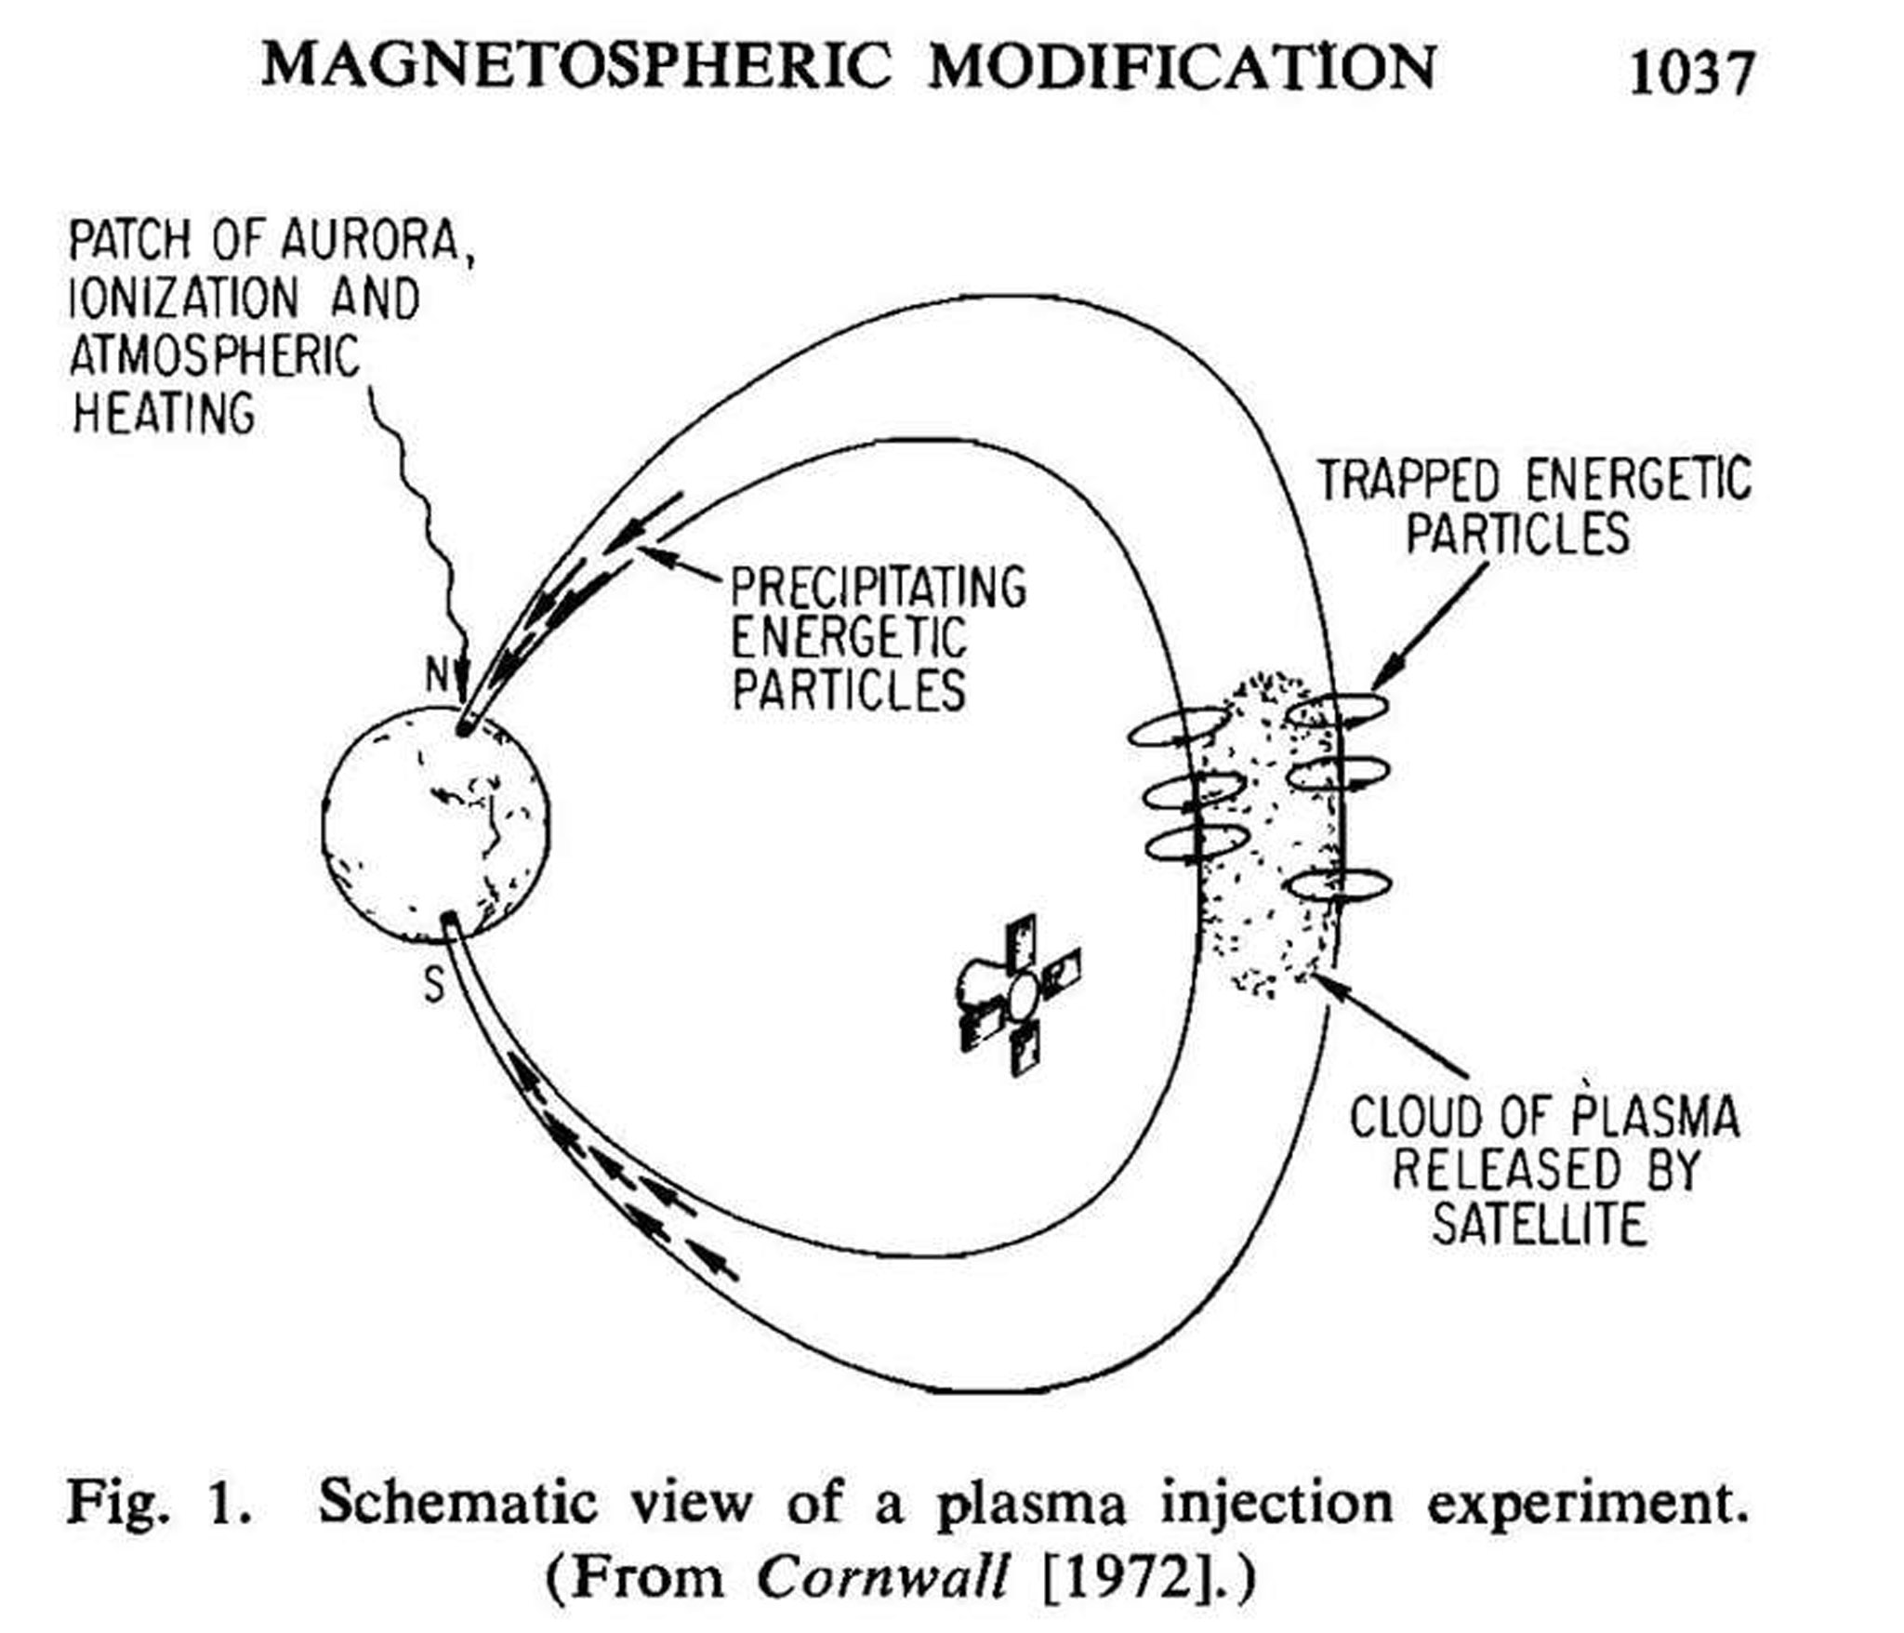
Space Weather Control (History)
Seeding Plasma with Sounding Rockets and Satellites
Create an artificial ion cloud in interplanetary space for studying the state of the interplanetary medium … sounding rocket experiments of May 1963
Notes:
https://weathermodificationhistory.com/plasma-seeding-magnetospheric-modification-begins/

Slide 14
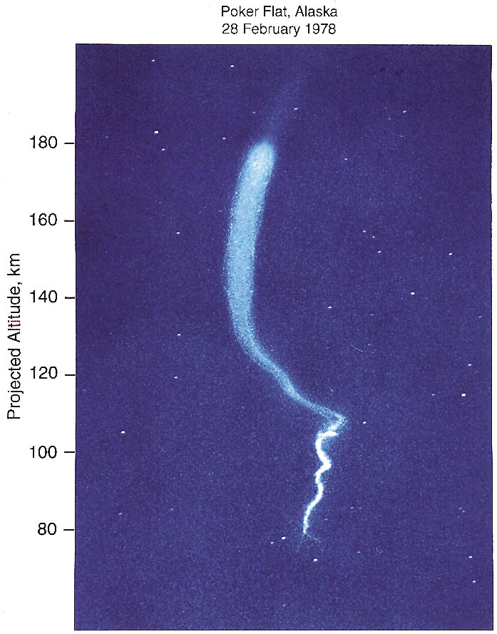
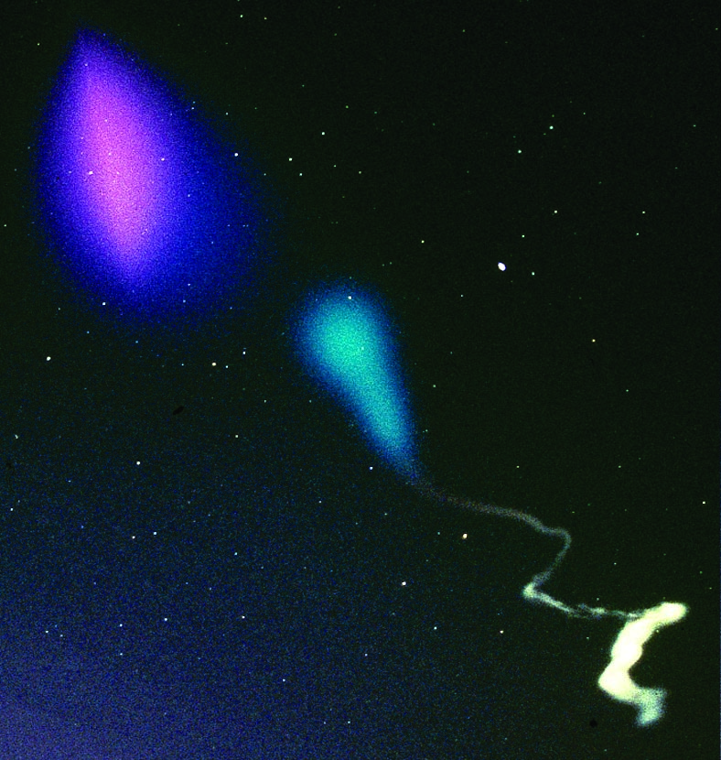
Space Weather Control (History)
Seeding Plasma with Sounding Rockets and Satellites
Image of a daytime lithium trail near 68 miles/110 kilometers altitude from a sounding rocket launched from Wallops Island, Virginia, in July 2013.
The cloud in the upper left hand part of the image is due to a barium release. The purple-red part is the ionized component which has become elongated along the Earth’s magnetic field lines. The purple-blue cloud that surrounds the red ionized barium is a combination of the neutral barium and strontium. The blue and white trail in the lower portion of the image is from a TMA vapor trail that reveals the neutral wind trails as a function of altitude.
Luminous vapor trail of tri-methyl aluminum (TMA) reveals neutral winds, shears, gravity waves, and instabilities in the high-latitude, upper atmosphere.
Notes:
https://weathermodificationhistory.com/tags/sounding-rocket/
https://www.nasa.gov/mission_pages/sounding-rockets/tracers/metals.html
https://weathermodificationhistory.com/WMH/pdf/care-bernhardt.pdf

Slide 15
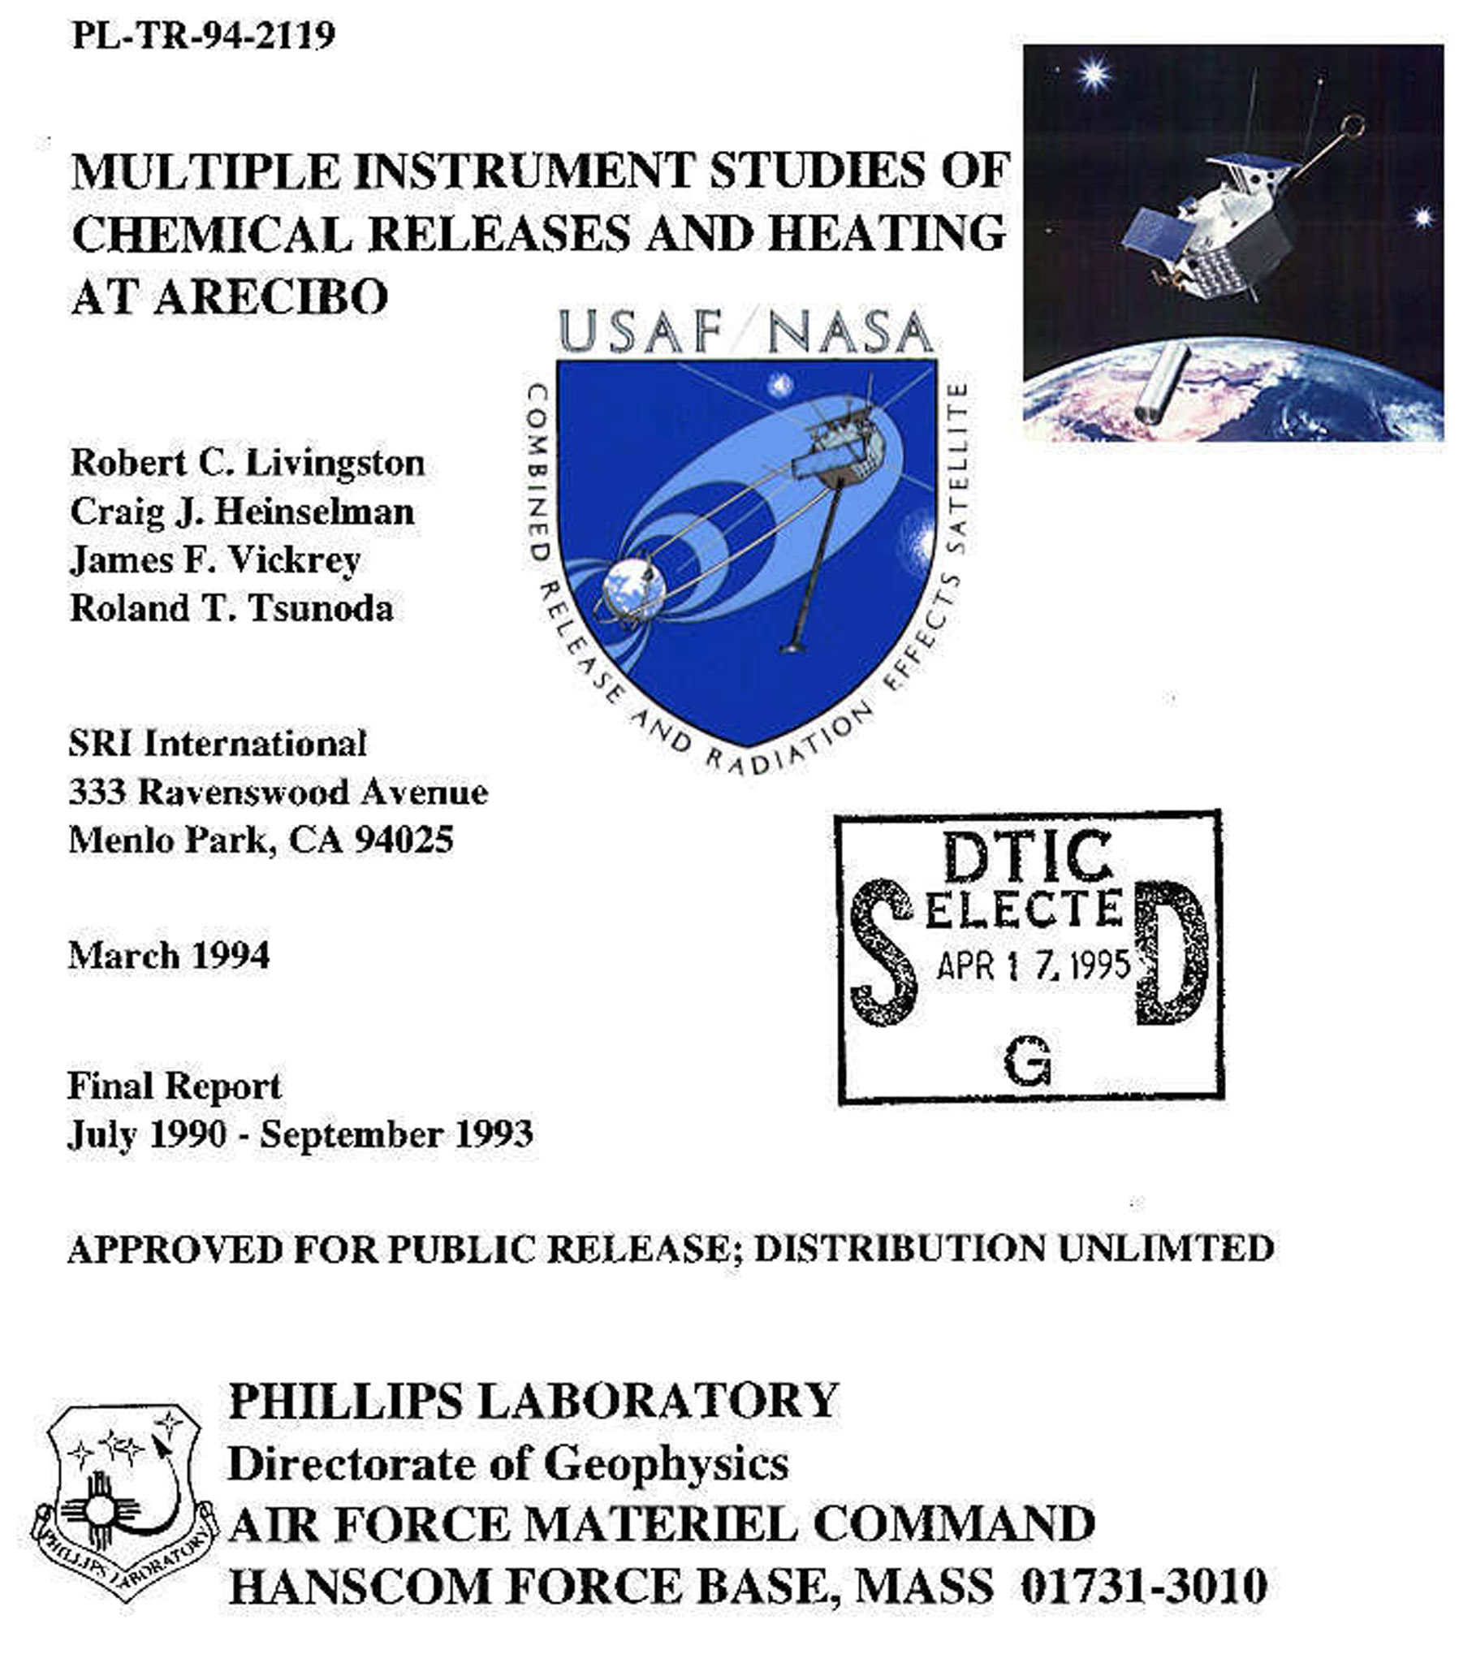
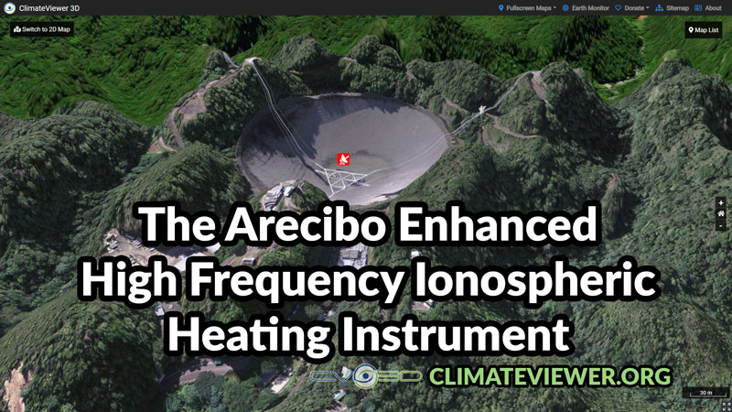
Space Weather Control (History)
Chemical Releases and Ionospheric Heating at Arecibo
Combined Release and Radiation Effects Satellite (CRRES) dumps chemicals in space while a ground-based microwave antenna in Arecibo, Puerto Rico heats them to modify the ionosphere. This heater was destroyed by a hurricane then rebuilt as the Enhanced HF Ionospheric Heating Instrument.
Chemicals Released by the CRRES:
• Barium
• Strontium
• Lithium
• Calcium
• Sulfur Hexaflouride (SF6)
Notes:
https://climateviewer.com/2018/11/05/arecibo-ionospheric-heater-is-boiling-the-tropics-november-3-9-2018/
https://weathermodificationhistory.com/combined-release-radiation-effects-satellite-crres-arecibo-ionospheric-heater/
http://www.dtic.mil/cgi-bin/GetTRDoc?AD=ADA293219
http://www-pw.physics.uiowa.edu/plasma-wave/crres/index.html
http://www-pw.physics.uiowa.edu/plasma-wave/crres/press-kit/detailed-experiments.html
http://www.naic.edu/
http://aip.scitation.org/doi/abs/10.1063/1.860193
https://digitalcommons.usu.edu/cgi/viewcontent.cgi?referer=https://www.google.com/&httpsredir=1&article=2708&context=smallsat

Slide 16
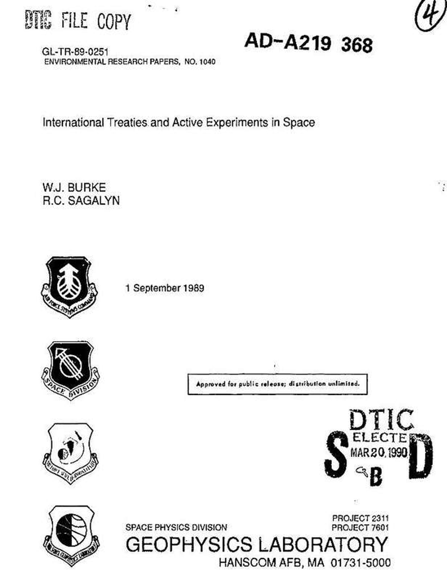
Space Weather Control (History)
International Treaties and Active Experiments in Space
Satellite explorations of the near earth environment have vastly increased our understanding of space plasmas and their interactions with systems. A logical next step involves active experiments in which small quantities of matter and energy are injected into space environments. These experiments seek to verify tentative, scientific understanding and to identify ways to control environmental effects on systems. Serious questions may be raised regarding the legitimacy of conducting active experiments in space under United States military auspices. Here we review the treaty obligations regarding space environment modification to which the United States government has committed itself. Experiments involving the detonation of nuclear devices or interference with foreign space assets, especially national technical means to verification, are explicitly forbidden. In planned these experiments great care must be exerted so that they produce no widespread, long-lasting or severe effects on the environment. We also review active experiments programs conducted by U.S. civilian and foreign space agencies. Finally, the treaty restrictions are applied to the case of a hypothetical experiment to establish the feasibility of controlling the flux of energetic particles trapped in the earth's radiation belts. An ability to reduce trapped radiation would increase orbit selection options for future space-based surveillance systems. Keywords: Radiation belts; Wave-particle interactions; Environment modification.
Notes:
https://weathermodificationhistory.com/internation-treaties-and-active-experiments-in-space/
http://oai.dtic.mil/oai/oai?verb=getRecord&metadataPrefix=html&identifier=ADA219368
https://climateviewer.com/enmod/

Slide 17
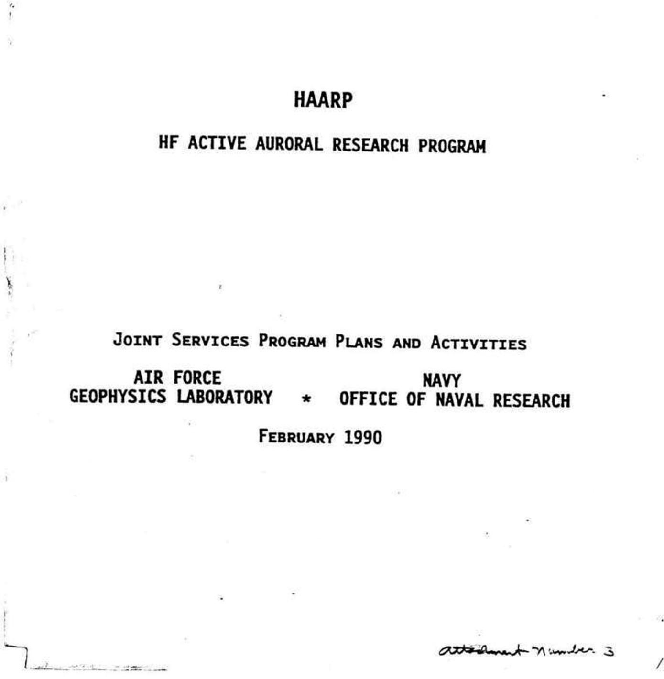
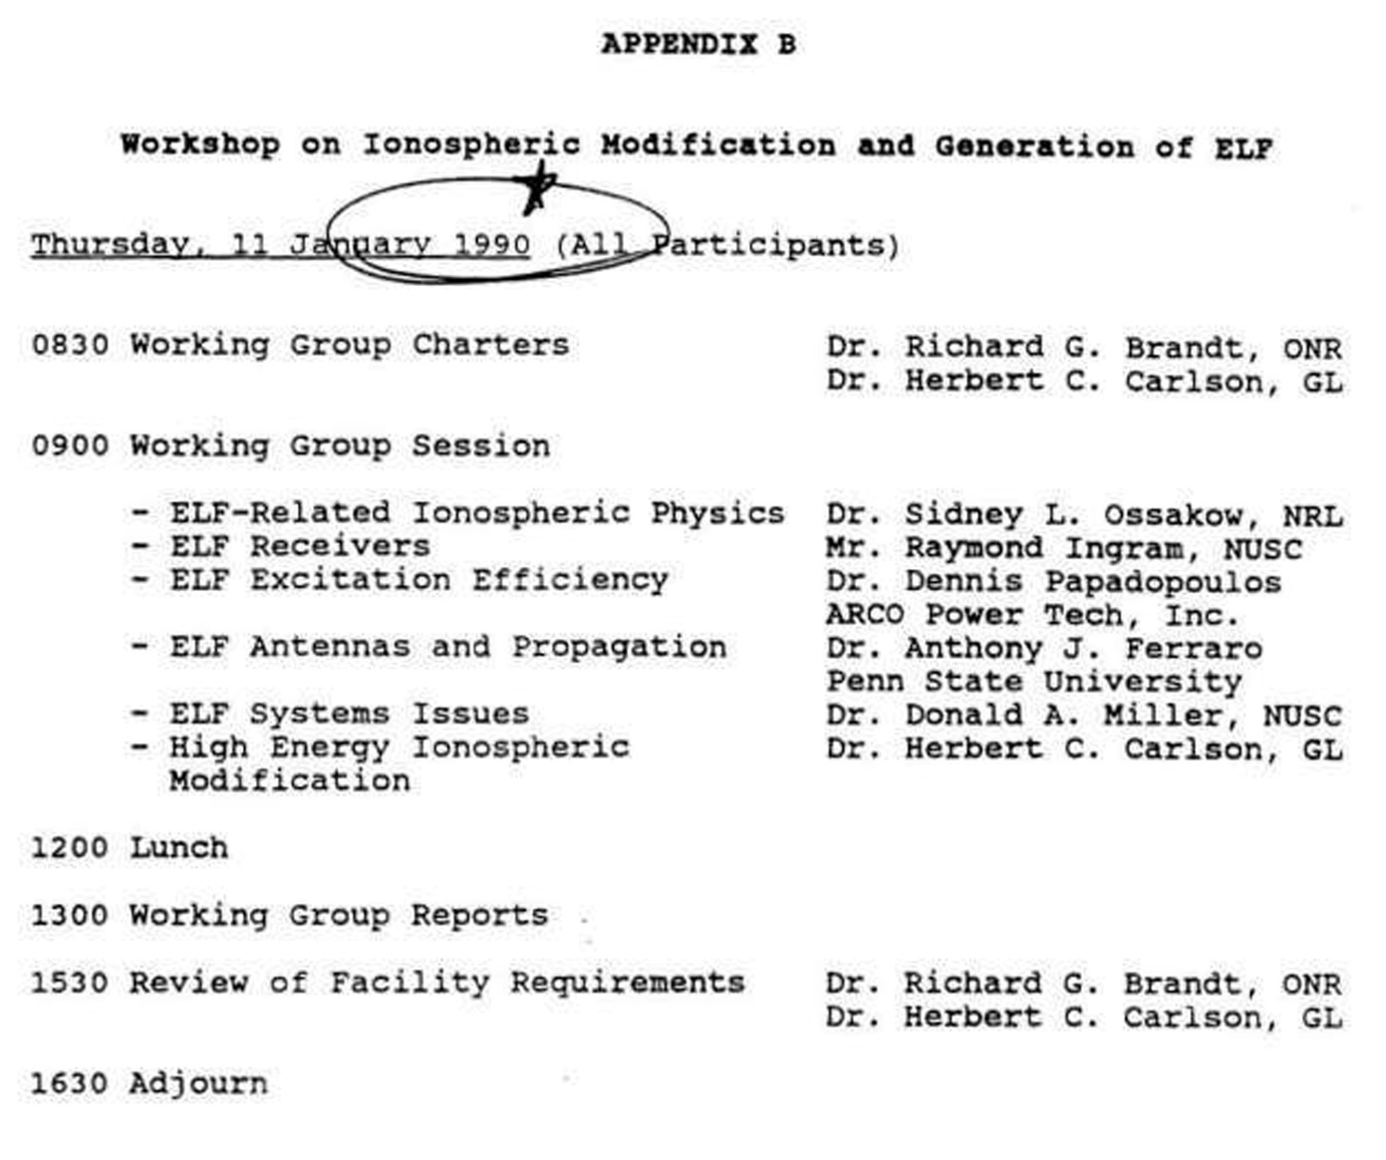
Space Weather Control (History)
Department of Defense Creates HAARP 1989-1990
Dec. 13, 1989: US Navy-Air Force meeting at Office of Naval Research to discuss mutual interests in carrying out a DoD program in the area of ionospheric modification. The need for a unique heating facility (HAARP) to conduct critical experiments relating to the potential DoD applications was identified. A Navy-Air Force-DARPA program was proposed.
Dec. 13, 1989: Navy-Air Force personnel present their proposed DoD program to DARPA and DDRE representatives at a meeting at DARPA.
Jan. 9-11, 1990: Ionospheric Modification/ELF Workshop held at NUSC, attended by personnel from government agencies, universities, and the private sector. The workshop provided an opportunity for broad-based inputs concerning research needs in ionospheric modification. In addition, potential systems applications requiring further research were defined, and the characteristics of a new, unique, HF heating facility were discussed and identified.
Jan. 25, 1990: Navy-Air Force meeting at the Geophysics Laboratory (Hanscom AFB, MA) to develop a plan to achieve DoD HAARP objectives.
Feb. 7, 1990: Written description of HAARP plans and objectives circulated to Navy, Air Force, and DARPA personnel for coordination.
Feb. 12, 1990: Meeting with DDR&E at ONR to present HAARP plan, and to discuss implementation approach.
Notes:
https://weathermodificationhistory.com/department-of-defense-haarp-steering-group-joint-services-program/
https://www.wired.com/images_blogs/dangerroom/2009/07/haarp_1990.pdf

Slide 18
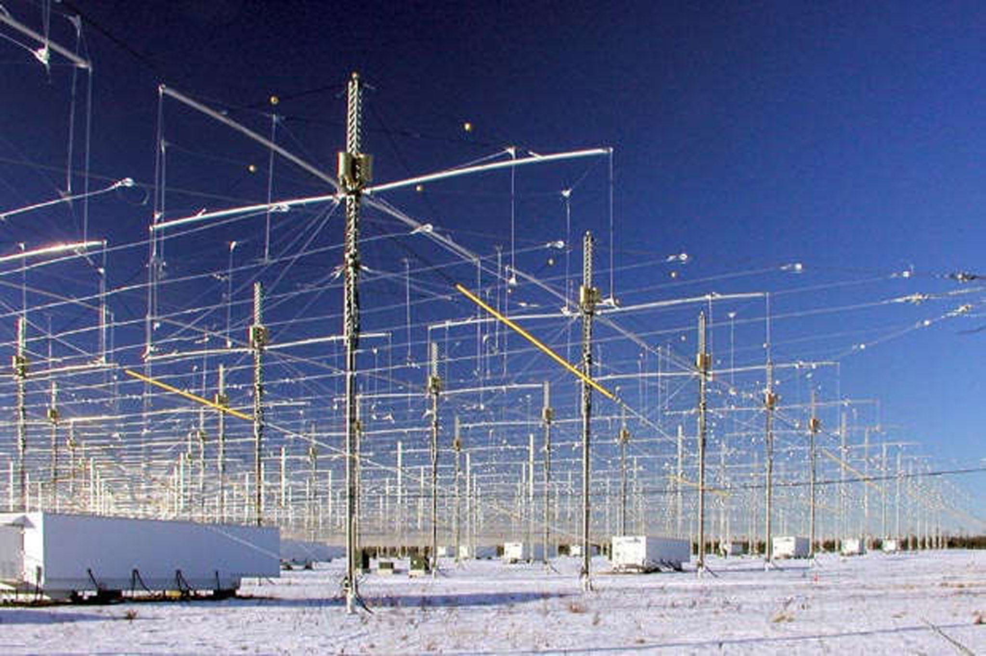
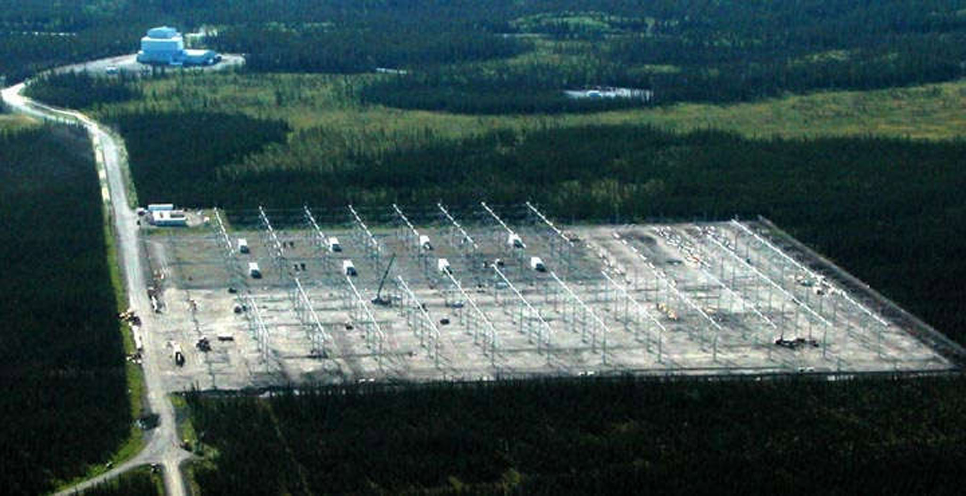
Space Weather Control (History)
HAARP operational 1994, running at full power 2006
The HAARP facility becomes operational, with a radiated power of 960 kW. 1994
HAARP IRI is completed, with 180 towers, 72’ tall, 80’ apart, each with two pairs of crossed dipole antennas (2.8 to 8.3 MHz)(7 to 10 MHz), and a radiated power of 3600 kW (3.6 Megawatts).
Notes:
https://weathermodificationhistory.com/high-frequency-active-auroral-research-program-haarp-operational/
https://weathermodificationhistory.com/haarp-ionospheric-research-instrument-iri-full-power/

Slide 19
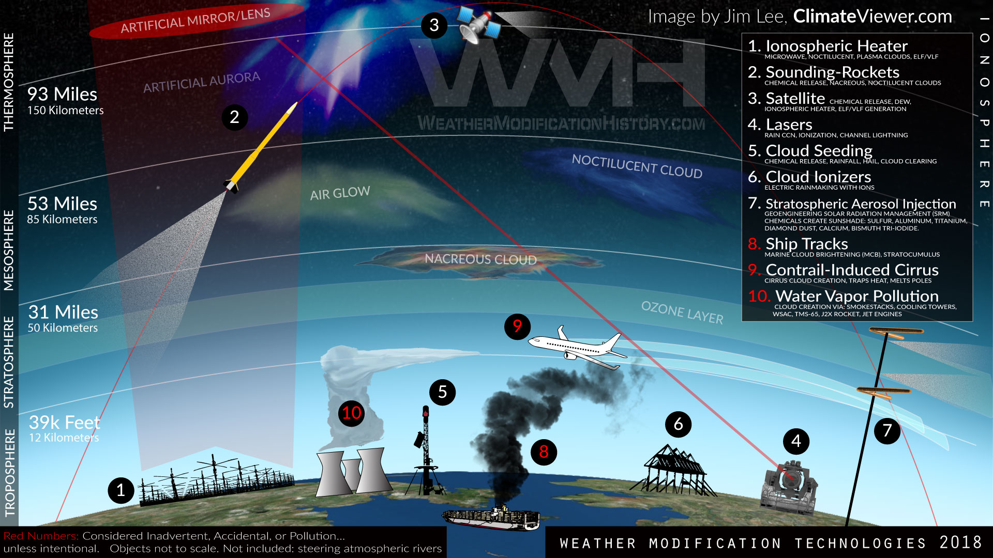
Notes:
https://climateviewer.com/2017/11/07/ten-technologies-to-own-the-weather-today/

Slide 20
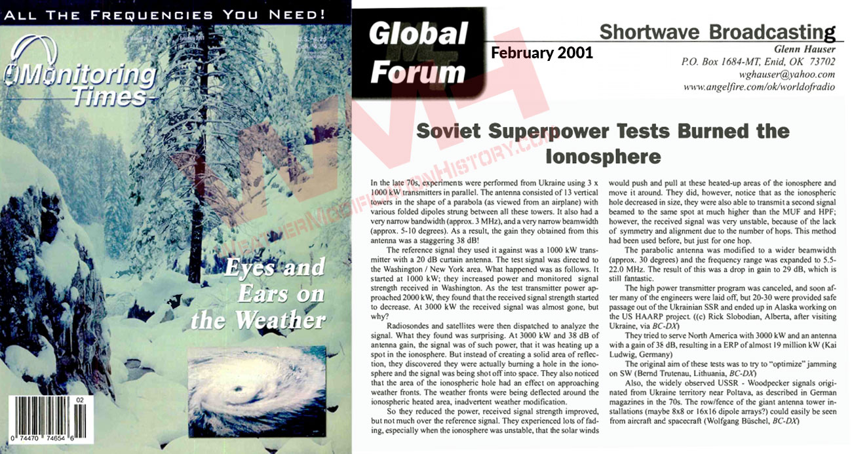
Space Weather Control
Terrestrial Weather Modification
In the late 70s, experiments were performed from Ukraine using 3 x 1000 kW transmitters in parallel. The antenna consisted of 13 vertical towers in the shape of a parabola (as viewed from an airplane) with various folded dipoles strung between all these towers. It also had a very narrow bandwidth (approx. 3 MHz), and a very narrow beamwidth (approx. 5-10 degrees). As a result, the gain they obtained from this antenna was a staggering 38 dB
But instead of creating a solid area of reflection, they discovered they were actually burning a hole in the ionosphere and the signal was being shot off into space. They also noticed that the area of the ionospheric hole had an effect on approaching weather fronts. The weather fronts were being deflected around the ionospheric heated area, inadvertent weather modification
^{Sov}iet Superpower Tests Burned the Ionosphere
Notes:
https://www.americanradiohistory.com/Archive-Monitoring-TImes/2000s/Monitoring-Times-2001-02.pdf
https://weathermodificationhistory.com/russian-woodpecker-ionospheric-heater-weather-warfare/

Slide 21
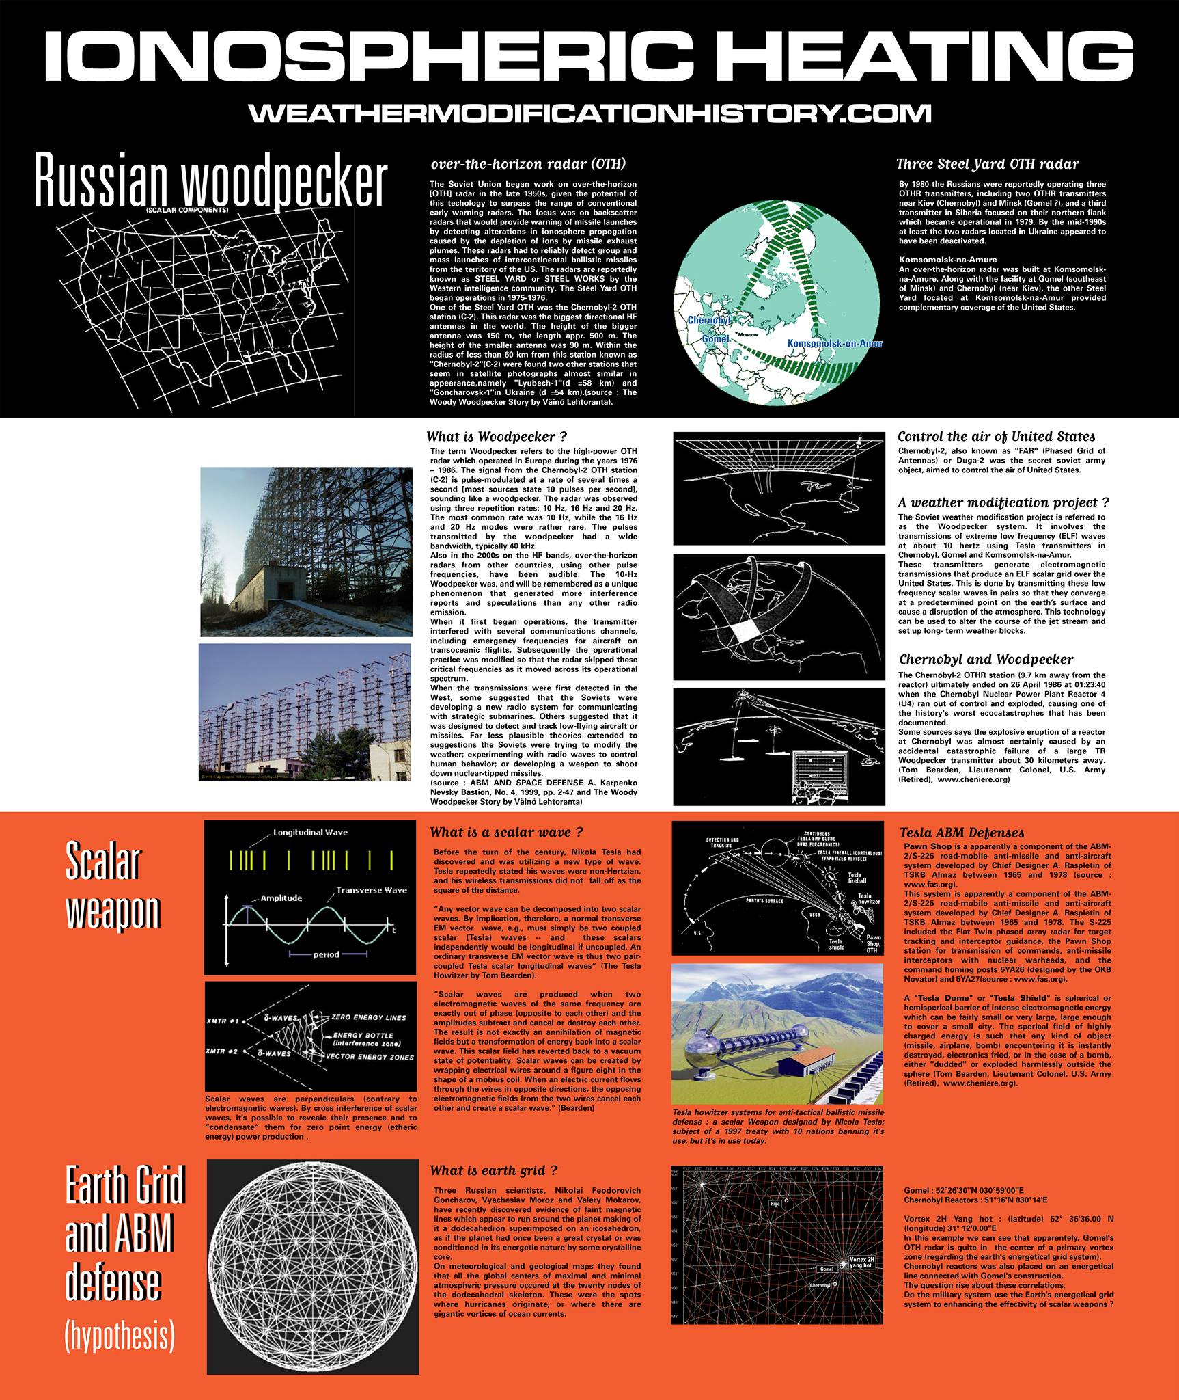
Space Weather Control
Terrestrial Weather Modification
The Russian Woodpecker (DUGA-3)
Notes:
https://climateviewer.com/2018/05/04/russian-woodpecker-chernobyl-meltdown-ionospheric-heating-over-usa-1983-1986/
http://climateviewer.org/pollution-and-privacy/atmospheric-sensors-and-emf-sites/maps/russian-woodpecker-duga-krug-radars/
https://weathermodificationhistory.com/russian-woodpecker-ionospheric-heater-weather-warfare/

Slide 22
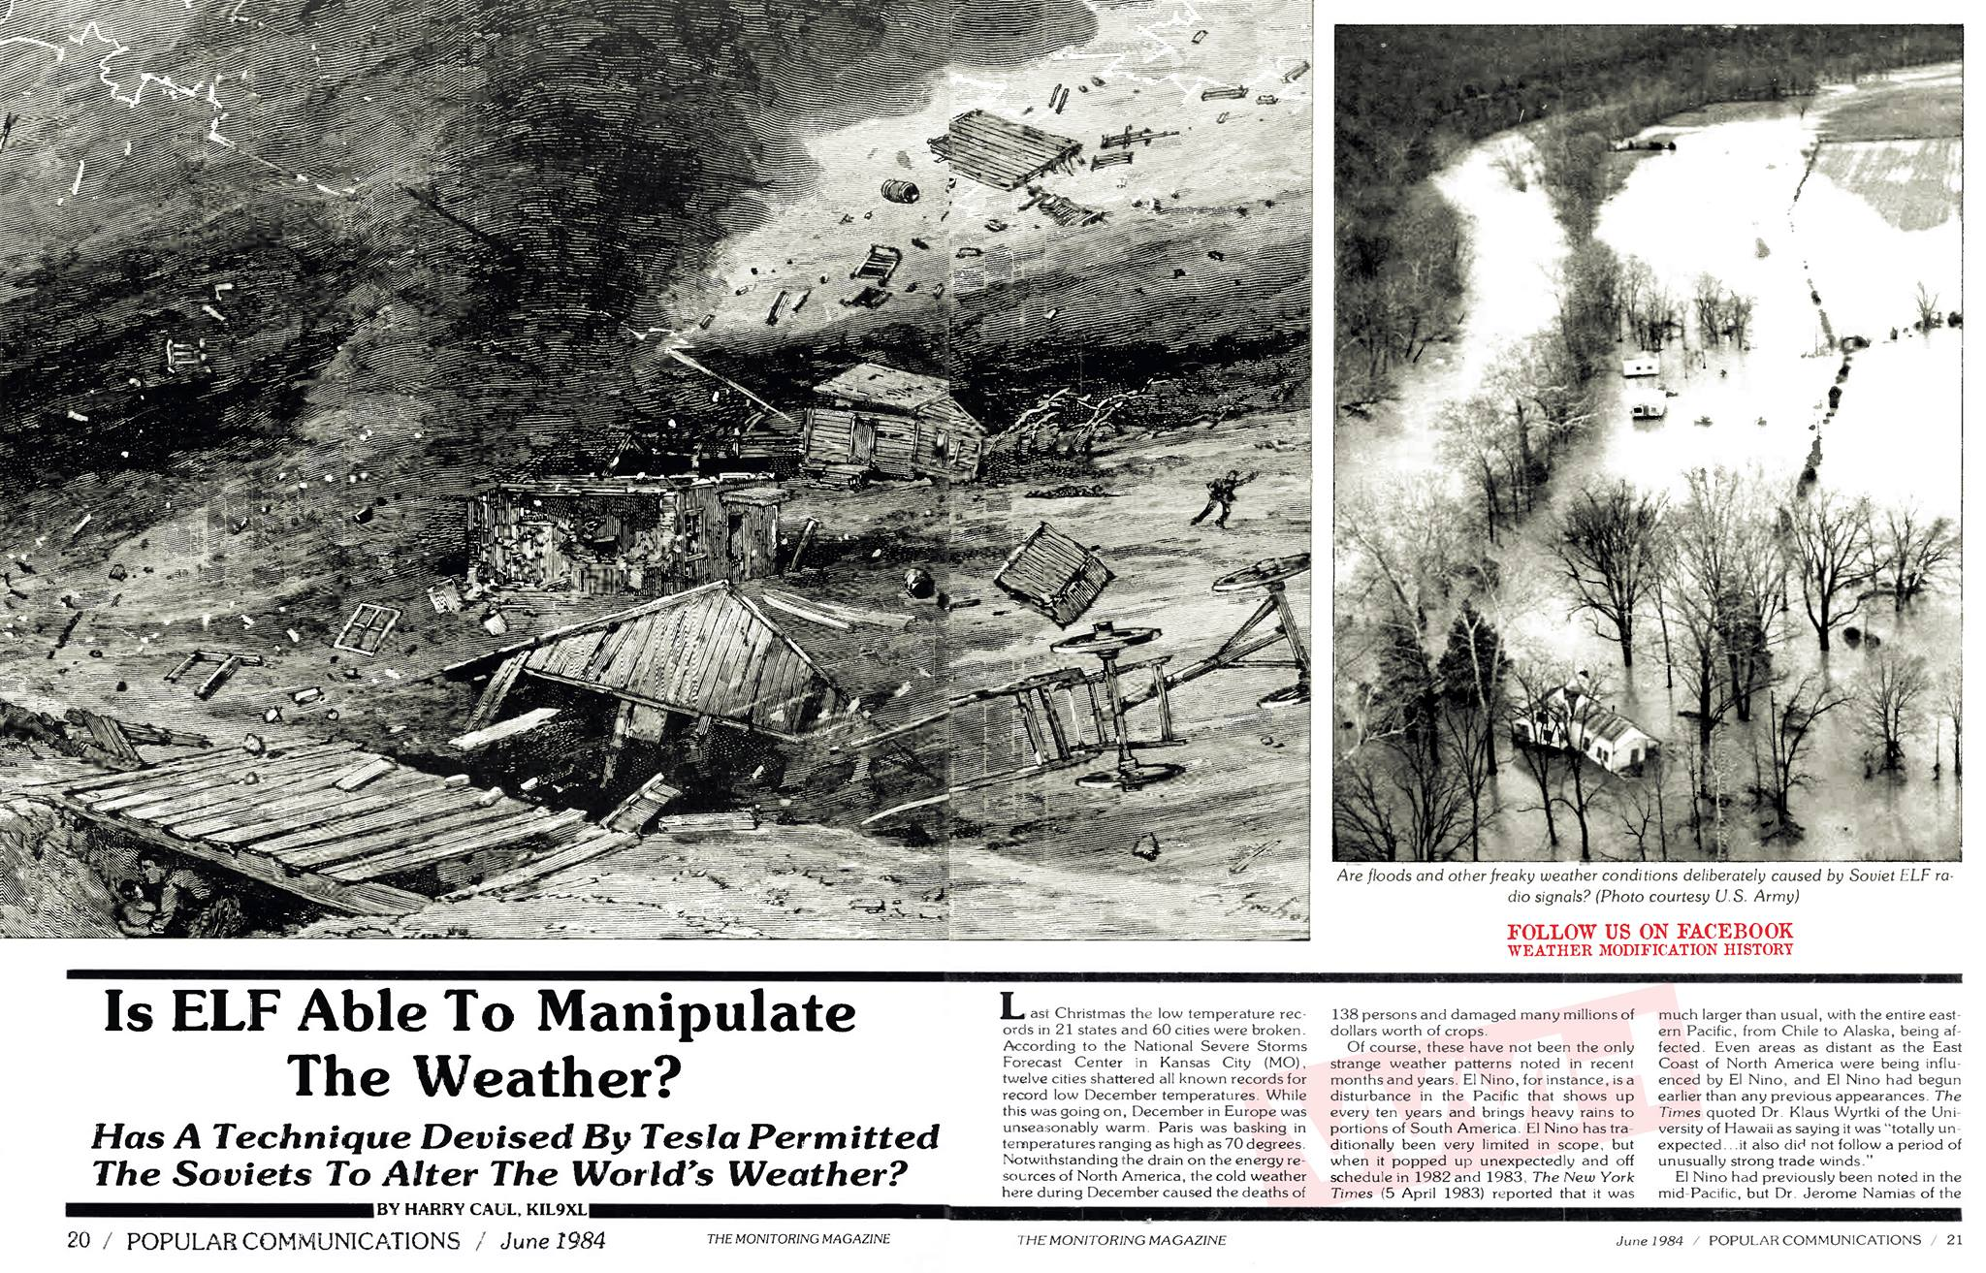
Space Weather Control
Terrestrial Weather Modification
The Russian Woodpecker (part 1)
Last Christmas the low temperature records in 21 states and 60 cities were broken. … caused the deaths of 138 persons and damaged many millions of dollars worth of crops. While this was going on, December in Europe was unseasonably warm. … El Nino popped up unexpectedly and off schedule in 1982 and 1983.
Notes:
https://climateviewer.com/2018/05/04/russian-woodpecker-chernobyl-meltdown-ionospheric-heating-over-usa-1983-1986/
https://weathermodificationhistory.com/russian-woodpecker-ionospheric-heater-weather-warfare/

Slide 23
Space Weather Control
Terrestrial Weather Modification
The Russian Woodpecker (part 2)
Dr. Andrew Michrowski, Canadian State Department: “In the Case of the winter of 1976-77, the Soviets managed to establish terrestrial electrical resonance, and then learned how to establish relatively stable and localized ELF magnetic fields, which were able to hamper or divert the jet stream flow in the Northern Hemisphere.”
He further stated, “As the columnar waves rotated clockwise, the westerly winds were sucked upwards counter-clockwise into the upper atmosphere, while a drag brough air from the upper atmosphere on the opposite side.”
Dr. Michrowski postulates that the Soviet ELF signals are pulses on a frequency of 31.5 Hz and have caused “giant standing wave troughs in the Rocky Mountains” between Alberta and New Mexico, and another through the eastern United States.
Notes:
https://climateviewer.com/2018/05/04/russian-woodpecker-chernobyl-meltdown-ionospheric-heating-over-usa-1983-1986/
https://weathermodificationhistory.com/russian-woodpecker-ionospheric-heater-weather-warfare/

Slide 24
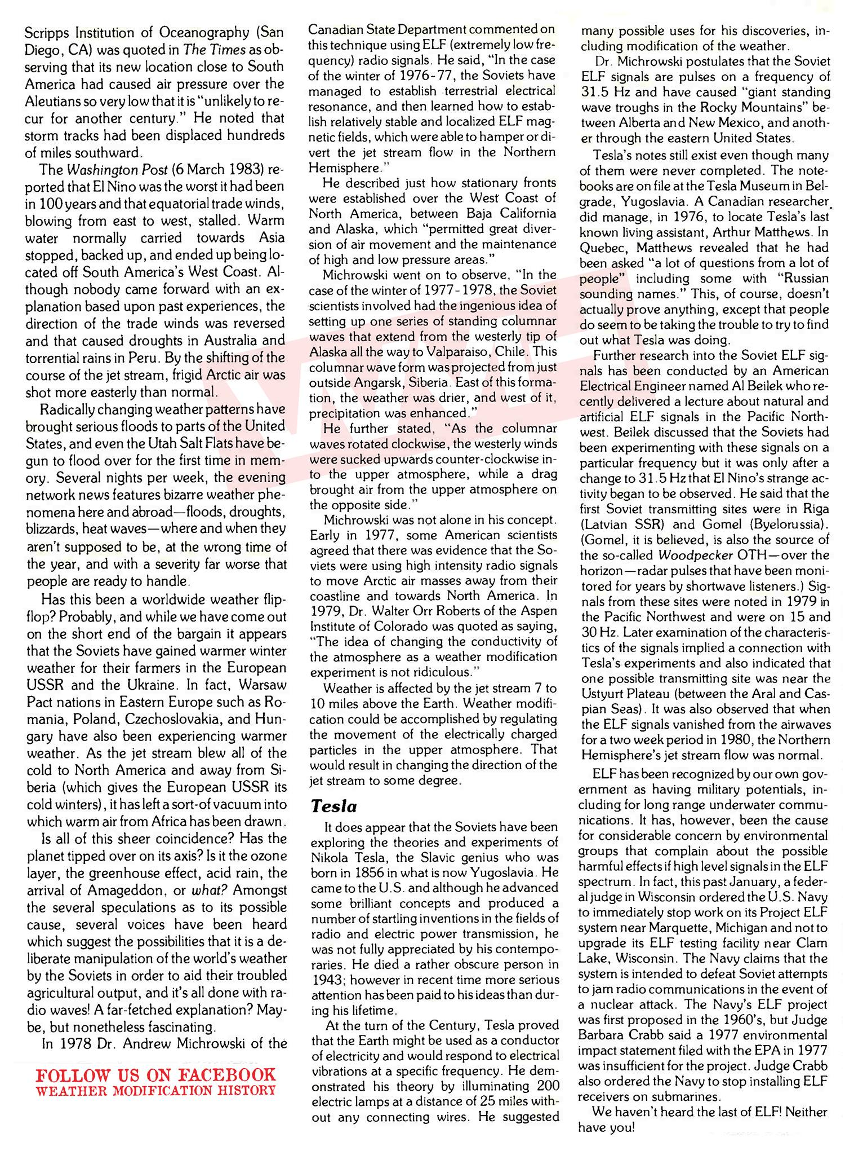
Space Weather Control
Terrestrial Weather Modification
The Russian Woodpecker (part 3)
Dr. Walter Orr Roberts, Aspen Institute of Colorado: “The idea of changing the conductivity of the atmosphere as a weather modification experiment is not ridiculous.”
Al Beilek, American Electrical Engineer discussed that the Soviets had been experimenting with these signals on a particular frequency but it was only after a change to 31.5 Hz that El Nino’s strange activity began to be observed.
The Washington Post (March 6, 1983) reported that El Nino was the worst it had been in 100 years and that equatorial trade winds, blowing from east to west, stalled.
Notes:
https://climateviewer.com/2018/05/04/russian-woodpecker-chernobyl-meltdown-ionospheric-heating-over-usa-1983-1986/
https://weathermodificationhistory.com/russian-woodpecker-ionospheric-heater-weather-warfare/

Slide 25
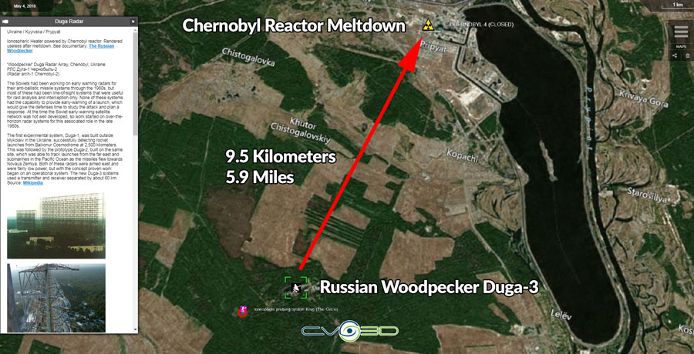
Space Weather Control
Terrestrial Weather Modification
The Russian Woodpecker (DUGA-3) Destroyed
Chernobyl Meltdown, April 26, 1986
Reactor 4 meltdown occurred 26 April 1986. The Exclusion Zone covers an area of approximately 2,600 km2 in Ukraine immediately surrounding the Chernobyl nuclear power plant where radioactive contamination from fallout is highest and public access and inhabitation are restricted.
This meltdown shut down the Russian Woodpecker at Chernobyl, three years after the “weather warfare” attack on the United States with standing waves, high pressure zones, and the El Nino.
Notes:
https://climateviewer.com/2018/05/04/russian-woodpecker-chernobyl-meltdown-ionospheric-heating-over-usa-1983-1986/
http://climateviewer.org/pollution-and-privacy/atmospheric-sensors-and-emf-sites/maps/russian-woodpecker-duga-krug-radars/
https://weathermodificationhistory.com/russian-woodpecker-ionospheric-heater-weather-warfare/
http://climateviewer.org/pollution-and-privacy/nuclear-radiation-and-waste/maps/1986-chernobyl-reactor-radioactive-fallout/

Slide 26
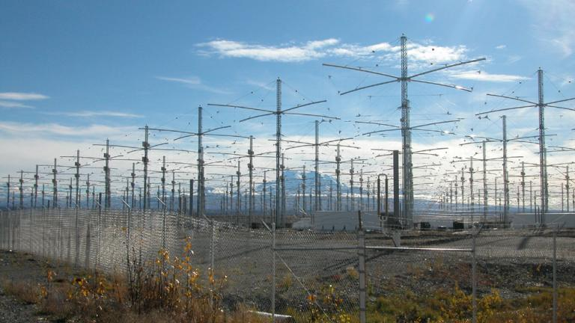
Space Weather Control
Climate Temperature Control and Ionospheric Holes
The Global Warming Pause
“Could these HAARP activities be the reason for troubling anomalies in our climate data and modelling? Anomalies capitalized upon by climate denying interests in their fight against climate activists and concerned scientists.”
Purposeful Anthropogenic Climate Alteration: RF Ionospheric Heater Arrogance (e.g. HAARP)
Notes:
Purposeful Anthropogenic Climate Alteration: RF Ionospheric Heater Arrogance (e.g. HAARP)
https://web.archive.org/web/20171025072820/https://climatex.mit.edu/purposeful-anthropogenic-climate-alteration-rf-ionospheric-heater-arrogance-eg-haarp
Climate change: The case of the missing heat
Sixteen years into the mysterious ‘global-warming hiatus’, scientists are piecing together an explanation.
https://www.nature.com/news/climate-change-the-case-of-the-missing-heat-1.14525

Slide 27
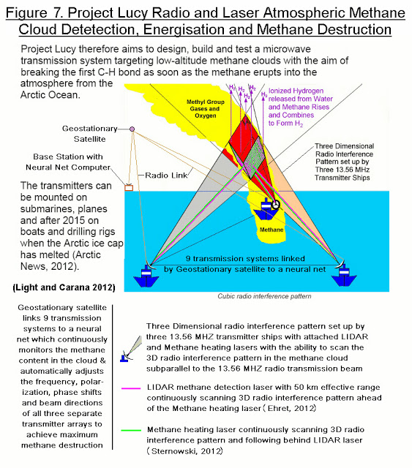
Space Weather Control
Climate Control
Project LUCY in the Sky With Diamonds
“Generating sunshine reflecting noctilucent clouds in increasing amounts in the mesosphere which will reflect the suns energy back into space.”
“noctilucent clouds formed from the breakdown of methane in a circular zone above the HAARP transmitter”
“4 other similar facilities in the world (Hipas, Alaska; Arecibo, Puerto Rico, EISCAT, Norway and Sura, Russia) where they could immediately attack the atmospheric methane as well.”
- Arctic Methane Emergency Group (AMEG)
Notes:
https://climateviewer.com/2014/04/01/haarp-lucy-sky-diamonds/

Slide 28
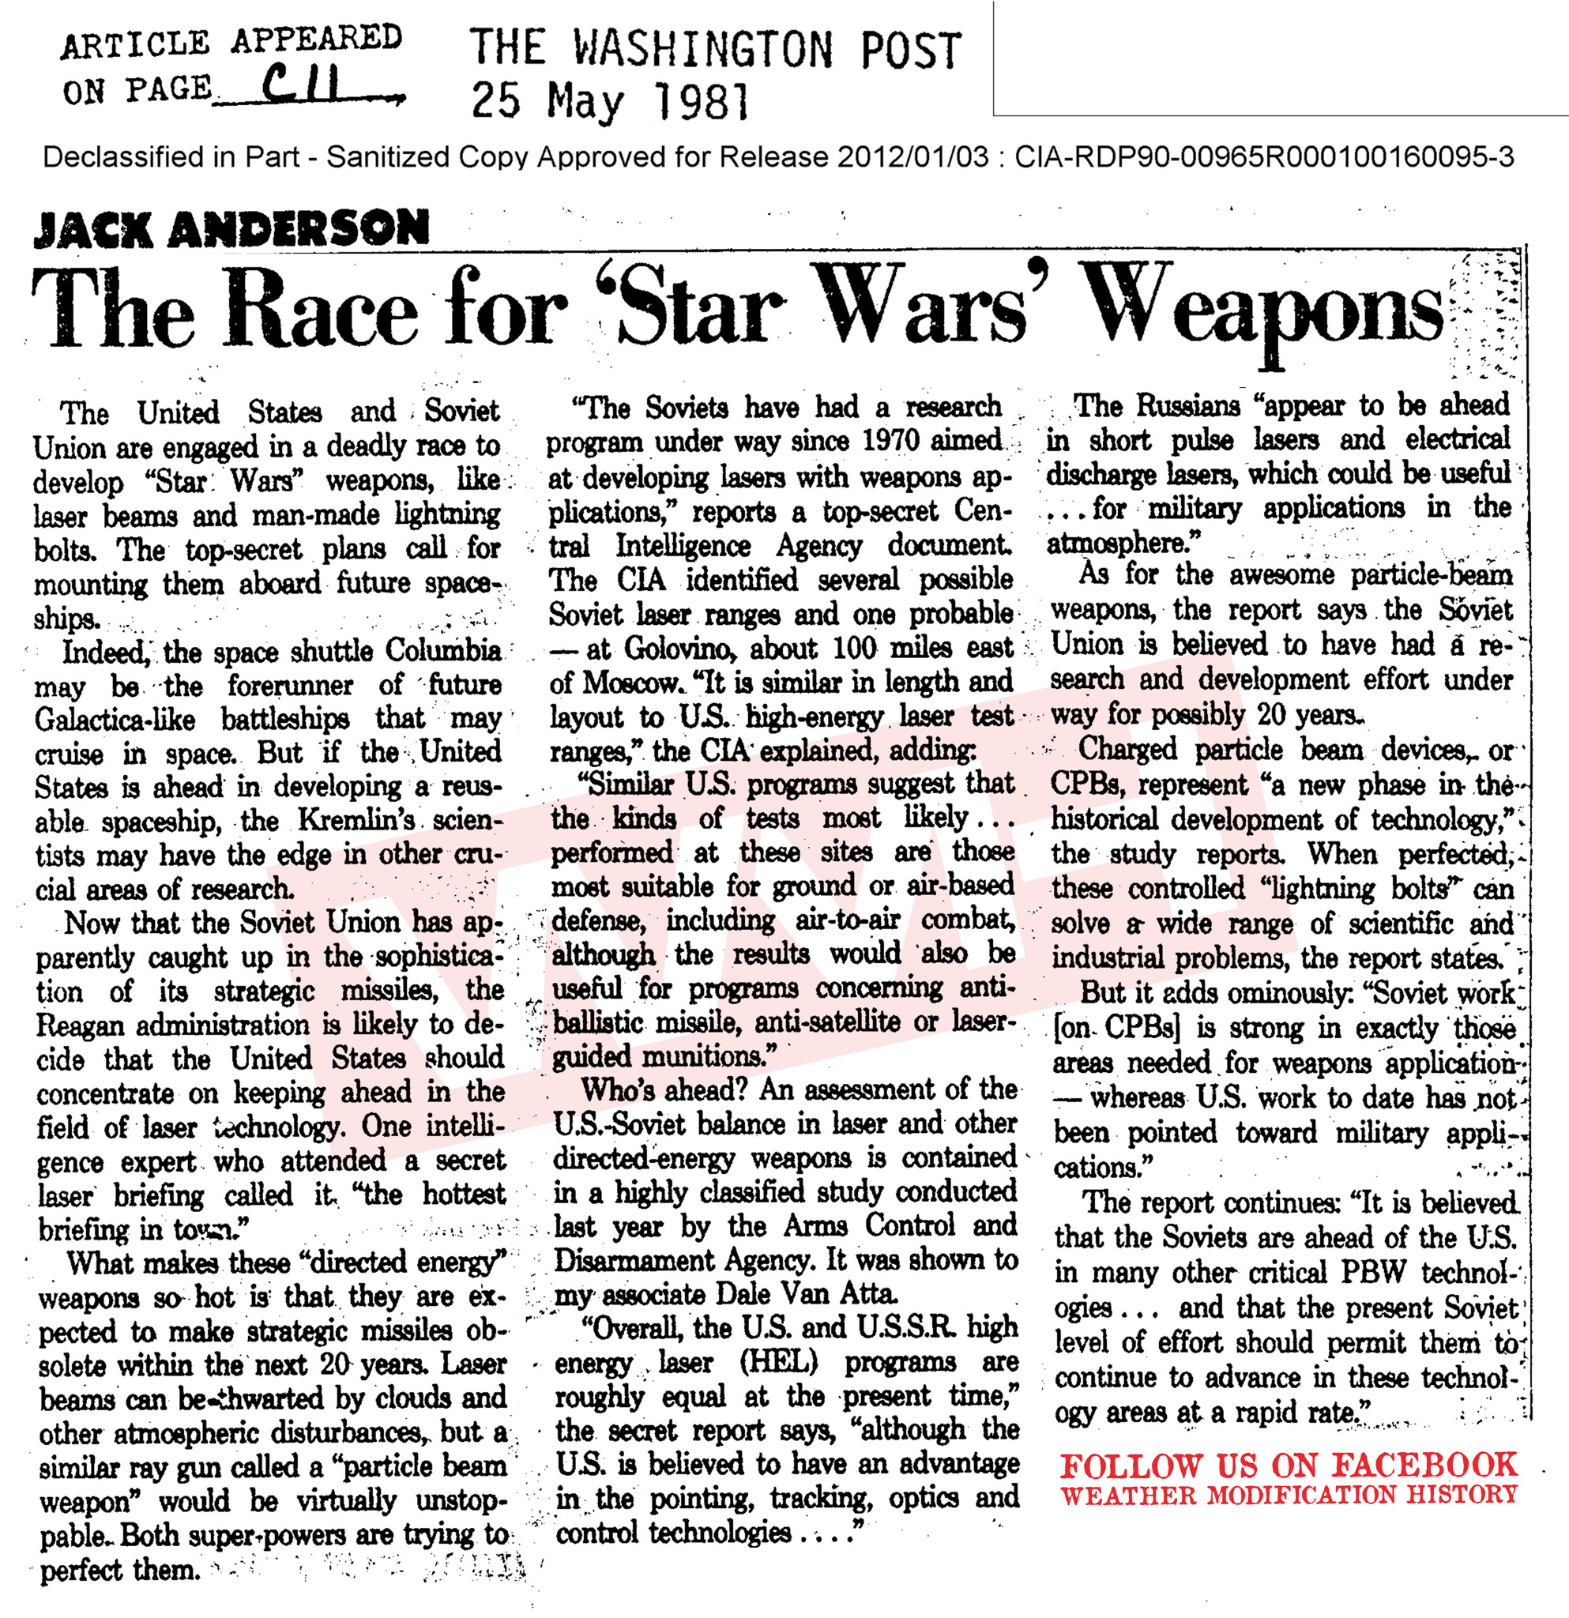
Space Warfare
“Overall, the U.S. and U.S.S.R. high energy laser (HEL) programs are roughly equal at present time”
^{Charged} particle beam devices, or CPBs, represent “a new phase in the historical development of technology,” the study reports. When perfected, these controlled “lightning bolts” can solve a wide range of scientific and industrial problems, the report states.
But it adds ominously: “Soviet work [on CPBs] is strong in exactly the areas needed for weapons application … It is believed that the Soviets are ahead of the U.S. in many other particle beam weapon (PBW) technologies.
Notes:
https://www.cia.gov/library/readingroom/document/cia-rdp90-00965r000100160095-3
https://www.cia.gov/library/readingroom/docs/CIA-RDP90-00965R000100160095-3.pdf
https://news.google.com/newspapers?id=POggAAAAIBAJ&sjid=8G0FAAAAIBAJ&pg=3593%2C4479149

Slide 29
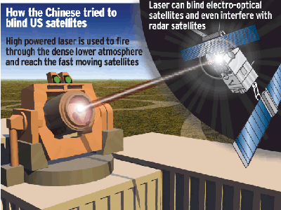
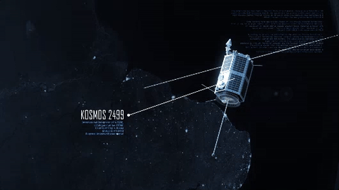
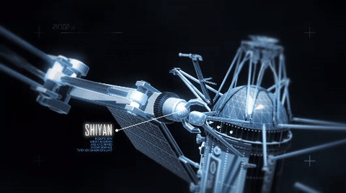
Space Warfare
China’s military is developing powerful lasers, electromagnetic railguns and high-power microwave weapons for use in a future “light war” involving space-based attacks on satellites.
Beijing’s push to produce so-called directed-energy weapons aims to neutralize America’s key strategic advantage: the web of intelligence, communication and navigation satellites enabling military strikes of unparalleled precision expeditionary warfare far from US shores.
^{Kamikaze Satellites}
Hijacker ^{Satellites}
Laser-Blinding ^{Satellites}
Notes:
https://climateviewer.com/2018/06/19/trumps-space-force-owning-the-weather-2025/
https://www.cnn.com/2016/11/29/politics/space-war-lasers-satellites-russia-china/index.html
https://nationalinterest.org/blog/the-buzz/get-ready-chinas-laser-weapons-arsenal-20138

Slide 30
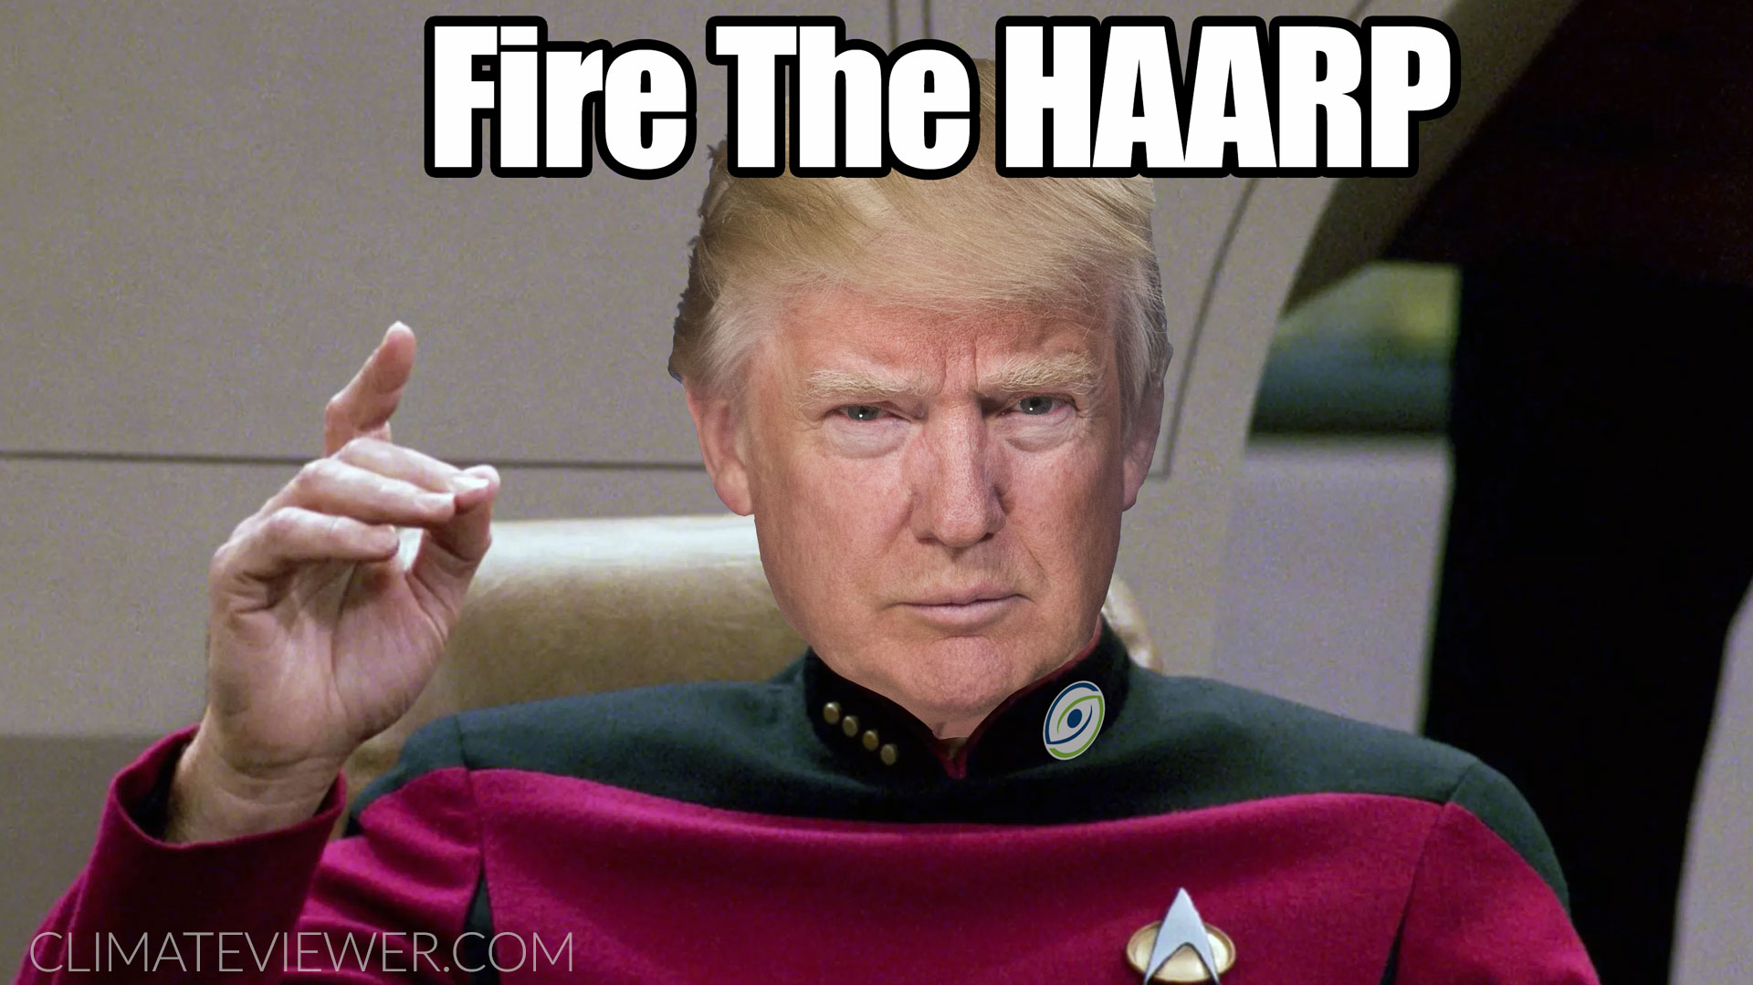
Trump’s Space Force: “Space, it’s where it’s at”
Notes:
https://climateviewer.com/2018/06/19/trumps-space-force-owning-the-weather-2025/
https://www.rollingstone.com/politics/news/trump-space-force-w521659

Slide 31
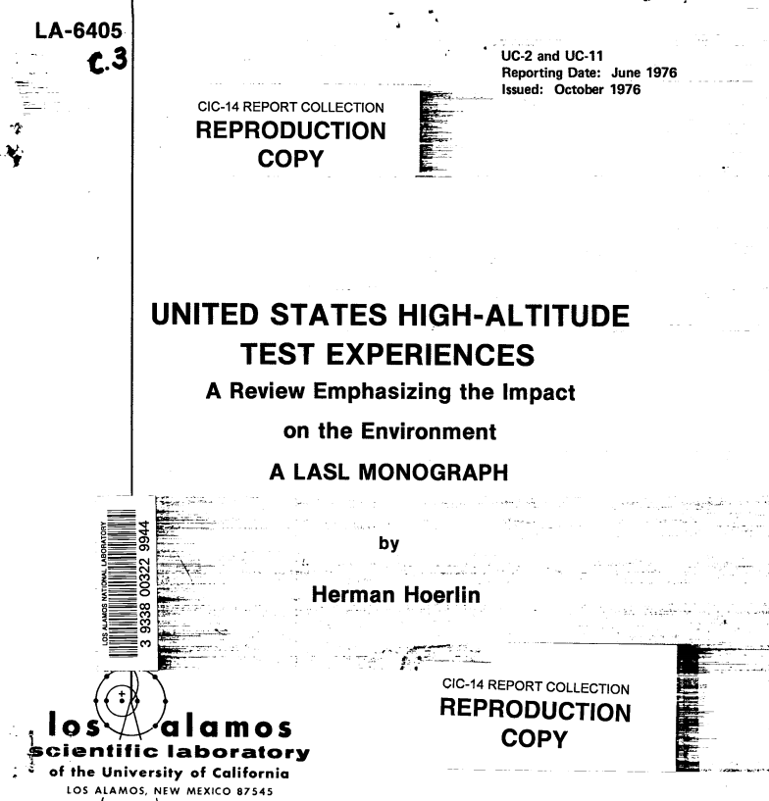
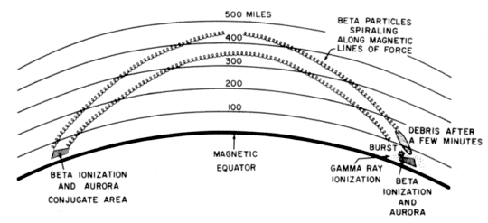
Radiation Belt Remediation (Artificial Aurora)
Christofilos Effect could fry satellites and Intercontinental Ballistic Missiles
The Christofilos effect would produce an area of highly charged particles at a selected location. It was believed that by flying through this region at high speeds, the warheads or guidance systems of attacking missiles might be damaged.
• Operation Argus (USA) August 27 - September 6, 1958
• Operation Hardtack (USA) - August 1-12, 1958
• Starfish Prime (USA) - July 9, 1962
• Operation K (Russia) - October 22 - November 1, 1962
Notes:
https://www.scribd.com/document/134612875/Satellite-Threat-Due-to-High-Altitude-Nuclear-Detonation-Eisenhower-Institute-Papadopoulos-Presentation-280369
https://en.wikipedia.org/wiki/List_of_artificial_radiation_belts
https://en.wikipedia.org/wiki/Christofilos_effect
https://www.scribd.com/document/134617164/Control-of-the-Energetic-Proton-Flux-in-the-Inner-Radiation-Belt-by-Artificial-Means-2009
https://fas.org/sgp/othergov/doe/lanl/docs1/00322994.pdf
https://weathermodificationhistory.com/limited-test-ban-treaty/

Slide 32
Radiation Belt Remediation & Artificial Aurora
Sucking radiation from space to prevent damage from EMP and Solar Flares
The electromagnetic pulse generated by the (nuclear) explosion and the “Christofilos Effect” — the creation of an artificial radiation belt around the Earth — could cripple “low Earth orbit” satellites and with them many of the world’s communications systems, Jane’s reported.
A high-altitude (nuclear) explosion “produces an artificial radiation belt that, within weeks to at most months, delivers a lethal dose of radiation to satellites,” said Dennis Papadopoulos, a scientist at the University of Maryland who worked with Nicholas Christofilos, who predicted the effect.
“If someone were to explode a 10-kiloton nuclear weapon at a high enough altitude over their own territory, 90 percent of the world’s low Earth orbit satellites would be lost within a month,” Papadopoulos said.
Notes:
https://www.scribd.com/document/134612875/Satellite-Threat-Due-to-High-Altitude-Nuclear-Detonation-Eisenhower-Institute-Papadopoulos-Presentation-280369
https://en.wikipedia.org/wiki/List_of_artificial_radiation_belts
https://en.wikipedia.org/w/index.php?title=Christofilos_effect&oldid=52642880
https://www.scribd.com/document/134617164/Control-of-the-Energetic-Proton-Flux-in-the-Inner-Radiation-Belt-by-Artificial-Means-2009
https://fas.org/sgp/othergov/doe/lanl/docs1/00322994.pdf
https://sites.google.com/alaska.edu/gakonahaarpoon/artificial-aurora

Slide 33
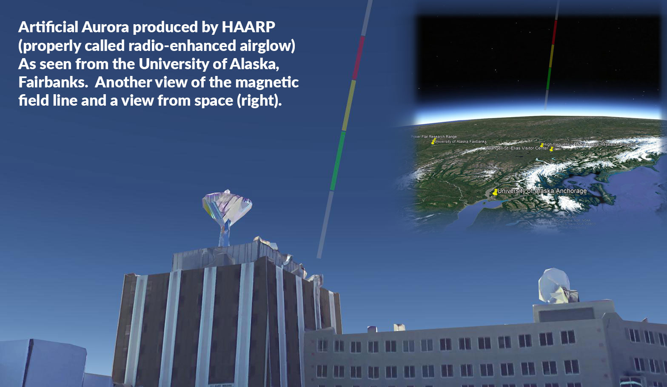
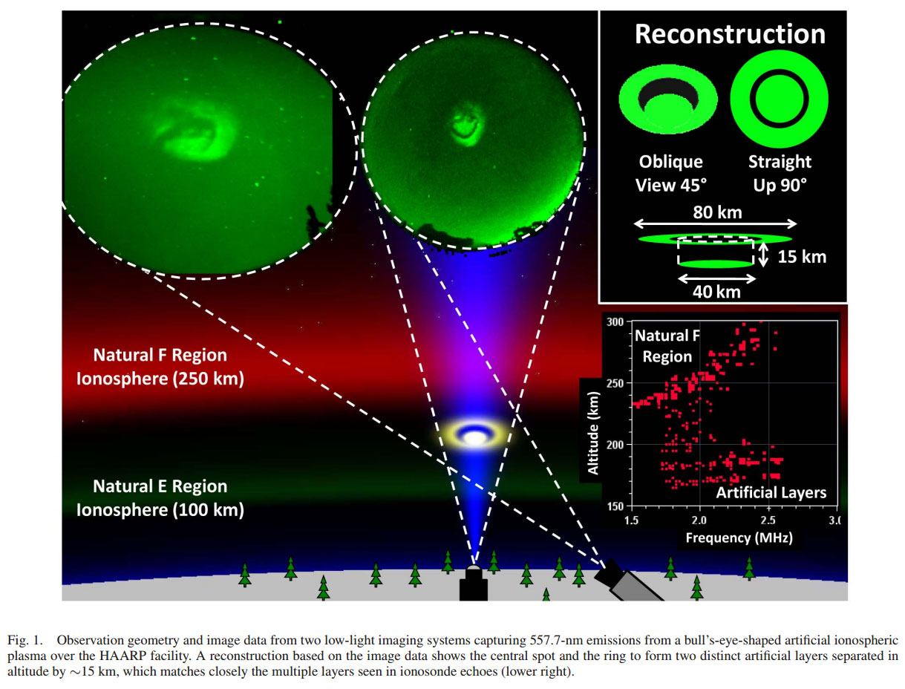
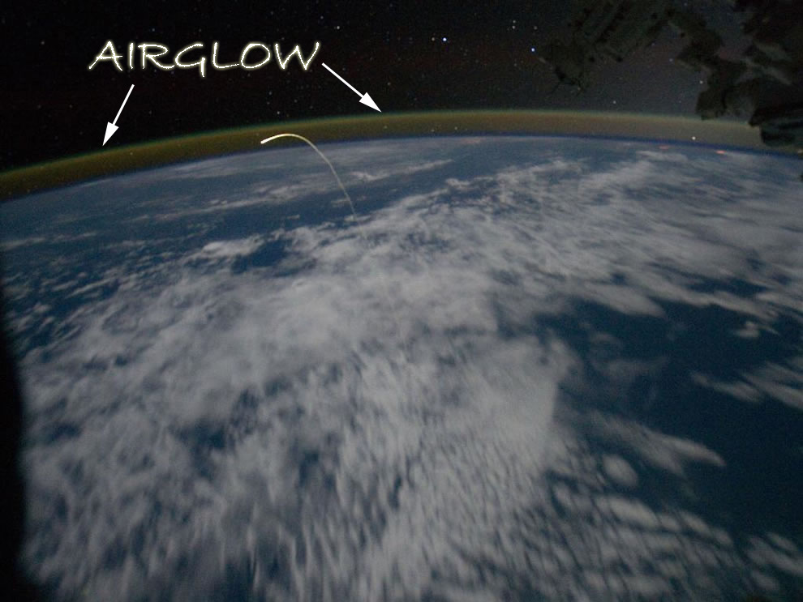
Radiation Belt Remediation & Artificial Aurora
CREATING “RADIO-ENHANCED AIRGLOW”
The artificial aurora (properly called radio-enhanced airglow) occurs at an approximate altitude of 150 to 300 km and can be photographed, conditions permitting, from distances several hundreds of kilometers from HAARP, including near the main population centers of Alaska: Anchorage, Fairbanks, and Juneau. The HAARP artificial aurora is usually not sufficiently luminous to be seen with the unaided eye except under exceptional conditions, and even the best case it is as bright (though much smaller in appearance) as the Andromeda galaxy.
Notes:
https://sites.google.com/alaska.edu/gakonahaarpoon/
https://sites.google.com/alaska.edu/gakonahaarpoon/artificial-aurora
https://climateviewer.com/2014/09/22/history-haarp-heating-holes-heaven/
https://climateviewer.com/2015/01/01/ionospheric-heaters-destroying-van-allen-belts-2/

Slide 34
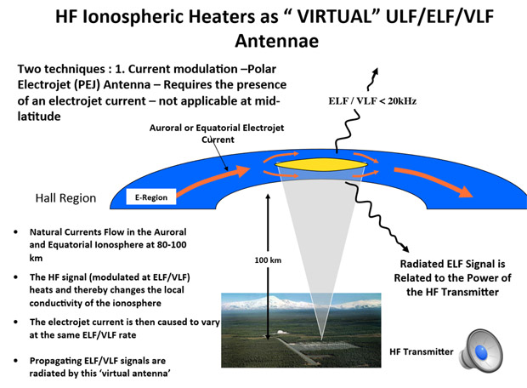
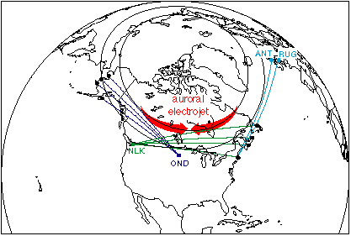
Extremely Low Frequency (ELF and ULF) Waves
Creating ELF from High Frequency Transmissions
Polar Electrojet (PEJ) Antenna
High-latitude Ionospheric Heaters can use the Electrojet, a naturally occurring electrical current in the D/E Region (70-90 km) of the ionosphere, as both an amplifier and virtual antenna. belts, hopping back and forth.
Ionospheric Heaters: How HAARP really works
Notes:
https://climateviewer.com/2014/10/18/ionospheric-heaters-how-haarp-really-works/
http://spp.astro.umd.edu/SpaceWebProj/Invited%20Talks/Active%20Experiments-2013.pdf – Using Active Experiments to Probe Geospace, Dennis Papadopoulos, University of Maryland
http://spp.astro.umd.edu/SpaceWebProj/Invited%20Talks/Barge%20Based%20ELF-2010.pdf - “On the Viability and Requirements of a Barge Based ELF System” Dennis Papadopoulos, University of Maryland, College Park, December 21, 2010
http://www.ipr.umd.edu/sites/default/files/documents/muri2014/Papadapolous-Arecibo-2014.pdf - “A New Paradigm in Sources and Physics of High-Power Ionospheric Modification” by Dennis Papadopoulos, University of Maryland, College Park, 20th Annual RF Ionospheric Interactions Workshop April 27‐30, 2014, Arecibo, Puerto Rico
http://spp.astro.umd.edu/SpaceWebProj/Invited%20Talks/Ionospheric%20Current%20Drive-2010.pdf - DARPA BRIOCHE Program, ONR MURI Program - “Ionospheric Current Drive (ICD) Implications to Naval Systems” Presentation to National Naval Responsibility (NNR) Underwater Communications Technical Panel by Dennis Papadopoulos, University of Maryland, College Park, September 22, 2010
http://www.ipr.umd.edu/sites/default/files/documents/Papadopoulos%20.pdf - “Mobile HF Sources Research & Applications” Physics of Ionospheric Modification, Theory & Laboratory Experiments, Dennis Papadopoulos – Gennady Milikh, University of Maryland, College Park, AFOSR MURI Kick­Off March 12, 2014

Slide 35
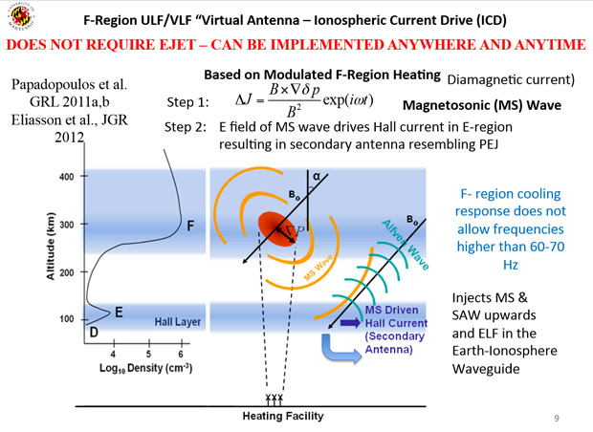
Extremely Low Frequency (ELF and ULF) Waves
Creating ELF from High Frequency Transmissions
Ionospheric Current Drive (ICD)
Both High Latitude and Equatorial Ionospheric Heaters may use an alternate method to produce UFL/ELF waves that does not require the Electrojet. By heating the F layer (150–800 km) of the ionosphere, Magnetosonic (MS) waves are create a secondary Alfven wave generator in the E Region. These Alfven waves travel upward and follow the Van-Allen belts, hopping back and forth. Ionospheric Heaters: How HAARP really works
Notes:
https://climateviewer.com/2014/10/18/ionospheric-heaters-how-haarp-really-works/
http://spp.astro.umd.edu/SpaceWebProj/Invited%20Talks/Active%20Experiments-2013.pdf – Using Active Experiments to Probe Geospace, Dennis Papadopoulos, University of Maryland
http://spp.astro.umd.edu/SpaceWebProj/Invited%20Talks/Barge%20Based%20ELF-2010.pdf - “On the Viability and Requirements of a Barge Based ELF System” Dennis Papadopoulos, University of Maryland, College Park, December 21, 2010
http://www.ipr.umd.edu/sites/default/files/documents/muri2014/Papadapolous-Arecibo-2014.pdf - “A New Paradigm in Sources and Physics of High-Power Ionospheric Modification” by Dennis Papadopoulos, University of Maryland, College Park, 20th Annual RF Ionospheric Interactions Workshop April 27‐30, 2014, Arecibo, Puerto Rico
http://spp.astro.umd.edu/SpaceWebProj/Invited%20Talks/Ionospheric%20Current%20Drive-2010.pdf - DARPA BRIOCHE Program, ONR MURI Program - “Ionospheric Current Drive (ICD) Implications to Naval Systems” Presentation to National Naval Responsibility (NNR) Underwater Communications Technical Panel by Dennis Papadopoulos, University of Maryland, College Park, September 22, 2010
http://www.ipr.umd.edu/sites/default/files/documents/Papadopoulos%20.pdf - “Mobile HF Sources Research & Applications” Physics of Ionospheric Modification, Theory & Laboratory Experiments, Dennis Papadopoulos – Gennady Milikh, University of Maryland, College Park, AFOSR MURI Kick­Off March 12, 2014

Slide 36
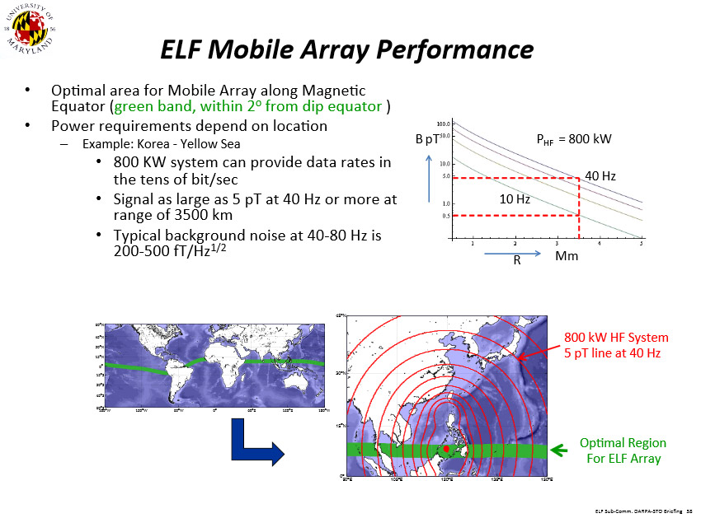
Extremely Low Frequency (ELF and ULF) Waves
Mobile Ionospheric Heaters on Boats
The Ionosphere controls the performance of critical DoD & civilian systems [ Communications range, radar, navigation, Geolocation accuracy, etc ]
• DoD/civilian active research using traditional ionospheric heaters provided new capabilities and applications that allow control/exploitation of triggered processes ( in space, artificial clouds, irregularity control,)
• The low power of traditional heaters resulted in large arrays and active elements, with complex and costly controls leading to fixed installations
• Fixed locations are associated with fixed magnetic geometry limiting the scope of the research investment
HAARP on a Boat? Ionospheric Heaters go Mobile!
Notes:
https://climateviewer.com/2014/10/22/haarp-boat-ionospheric-heaters-go-mobile/
http://spp.astro.umd.edu/SpaceWebProj/Invited%20Talks/Barge%20Based%20ELF-2010.pdf - “On the Viability and Requirements of a Barge Based ELF System” Dennis Papadopoulos, University of Maryland, College Park, December 21, 2010
http://www.ipr.umd.edu/sites/default/files/documents/muri2014/Papadapolous-Arecibo-2014.pdf - “A New Paradigm in Sources and Physics of High-Power Ionospheric Modification” by Dennis Papadopoulos, University of Maryland, College Park, 20th Annual RF Ionospheric Interactions Workshop April 27‐30, 2014, Arecibo, Puerto Rico
http://spp.astro.umd.edu/SpaceWebProj/Invited%20Talks/Ionospheric%20Current%20Drive-2010.pdf - DARPA BRIOCHE Program, ONR MURI Program - “Ionospheric Current Drive (ICD) Implications to Naval Systems” Presentation to National Naval Responsibility (NNR) Underwater Communications Technical Panel by Dennis Papadopoulos, University of Maryland, College Park, September 22, 2010
http://www.ipr.umd.edu/sites/default/files/documents/Papadopoulos%20.pdf - “Mobile HF Sources Research & Applications” Physics of Ionospheric Modification, Theory & Laboratory Experiments, Dennis Papadopoulos – Gennady Milikh, University of Maryland, College Park, AFOSR MURI Kick­Off March 12, 2014

Slide 37
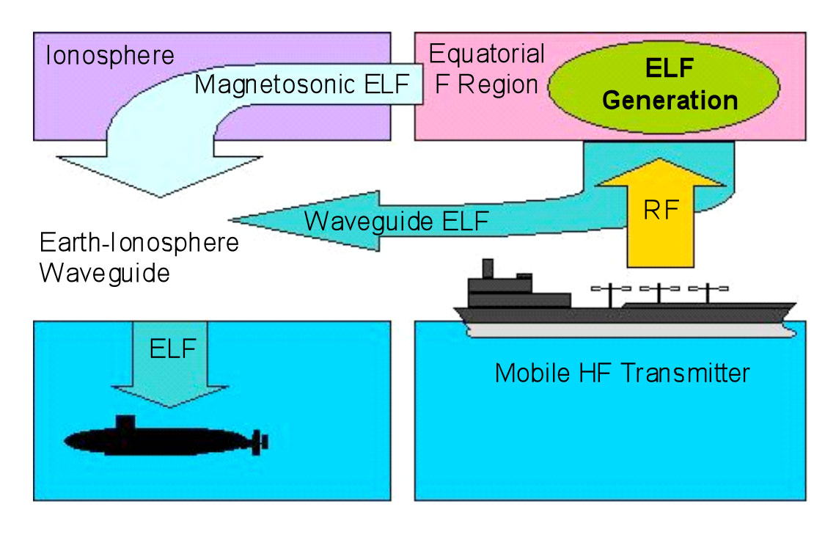
Extremely Low Frequency (ELF and ULF) Waves
Signaling the Apocalypse: Talking to Submarines
Pre-emptive nuclear strike
ELF waves are sent to submarines telling them to surface so they can receive radio frequency or laser-based instructions (launch codes and targets) from military commanders.
These instructions will not reach underwater, however, ELF and ULF waves reach the bottom of the ocean.
In nuclear strategy, a first strike is a preemptive surprise attack employing overwhelming force. First strike capability is a country's ability to defeat another nuclear power by destroying its arsenal to the point where the attacking country can survive the weakened retaliation while the opposing side is left unable to continue war. The preferred methodology is to attack the opponent's strategic nuclear weapon facilities (missile silos, submarine bases, bomber airfields), command and control sites, and storage depots first. The strategy is called counterforce.
Notes:
https://en.wikipedia.org/wiki/Pre-emptive_nuclear_strike
https://en.wikipedia.org/wiki/Counterforce
http://spp.astro.umd.edu/SpaceWebProj/Invited%20Talks/Barge%20Based%20ELF-2010.pdf

Slide 38
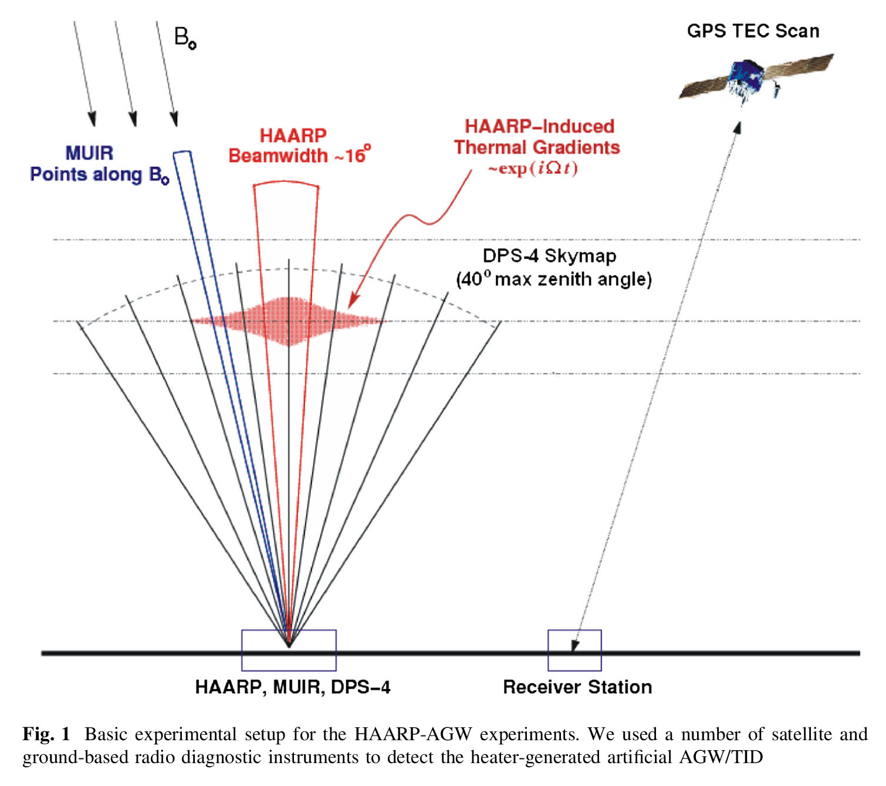
Extremely Low Frequency (ELF and ULF) Waves
Artificial Gravity Waves (AGW) and Traveling Ionospheric Disturbances (TID)
“Results of our ionospheric HF heating experiments to generate artificial acoustic-gravity waves (AGW) and traveling ionospheric disturbances (TID), which were conducted at the High-frequency Active Auroral Research Program (HAARP) facility in Gakona, Alaska.
The result of our experiments at the HAARP facility indicates that artificial AGW/TID can be generated in the ionosphere by the means of a modulated HF heating.
During the modulated heating, MUIR radar detected that the wind velocity outside the heated plasma volume was oscillating periodically with the same frequency as that of the heater power modulation cycle.”
Generation of Artificial Acoustic-Gravity Waves and Traveling Ionospheric Disturbances in HF Heating Experiments
Notes:
Generation of Artificial Acoustic-Gravity Waves and Traveling Ionospheric Disturbances in HF Heating Experiments
https://dspace.mit.edu/openaccess-disseminate/1721.1/105836
Atmospheric gravity waves generated in the high‐latitude ionosphere: A review
https://agupubs.onlinelibrary.wiley.com/doi/pdf/10.1029/RG020i002p00293
F2-region atmospheric gravity waves due to high-power HF heating and subauroral polarization streams
https://agupubs.onlinelibrary.wiley.com/doi/pdf/10.1029/2012GL052004
Investigation of acoustic gravity waves created by anomalous heat sources: experiments and theoretical analysis
http://iopscience.iop.org/article/10.1088/0031-8949/2013/T155/014028/meta

Slide 39
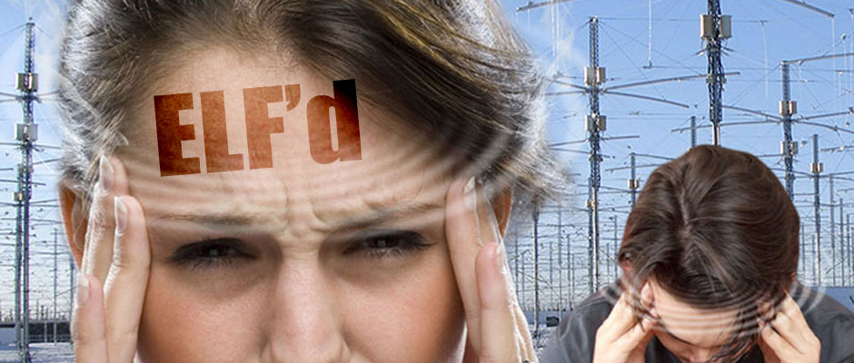
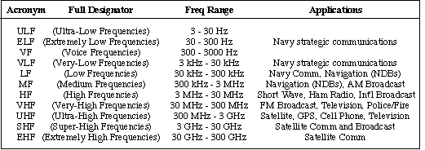
Extremely Low Frequency (ELF and ULF) Waves
Mind Control – Influencing Nervous Systems by Electrical Methods
Extremely Low Frequency (ELF) waves: ELF waves up to 100 Hz are once more naturally occurring, but they can also be produced artificially (such as for the Navy’s Project Sanguine for submarine communication). ELF-waves are not normally noticed by the unaided senses, yet their resonant effect upon the human body has been connected to both physiological disorders and emotional distortion.
"From PSYOP to MindWar: The Psychology of Victory.“
HAARP program, and not controlled by the global community, will create weapons capable of breaking radio communication lines and equipment installed on spaceships and rockets, provoke serious accidents in electricity networks and in oil and gas pipelines and have a negative impact on the mental health of people populating entire regions, the deputies said. They demanded that an international ban be put on such large-scale geophysical experiments.
Russian parliament concerned about US plans to develop new weapon
Notes:
HAARP, ELF Generation, and Mass Mind Control
https://climateviewer.com/2014/10/11/haarp-elf-generation-mass-mind-control/
Valley, Colonel Paul E., and Major Michael A. Aquino. "From PSYOP to MindWar: The Psychology of Victory." San Francisco: Presidio, US Army Reserves 7th Psychological Operations Group (2003).
https://www.scribd.com/document/216638135/MindWar-Co-Authored-by-Michael-Aquino
Russian parliament concerned about US plans to develop new weapon
https://fas.org/irp/program/collect/haarp-duma.htm

Slide 40
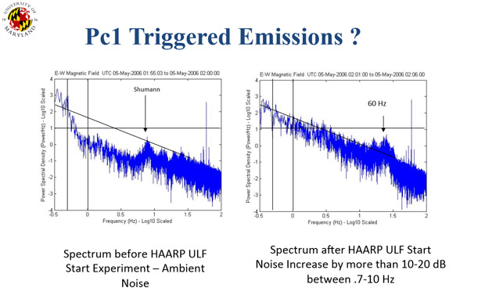
Extremely Low Frequency (ELF and ULF) Waves
Mind Control – Snuffing the Schumann Resonance
Schumann resonances: 7.83, 14, 20, 26, 33, 39 & 45 Hz.
Resonant frequency of the planet Earth which is 10 Hz as Nikola Tesla discovered.
Damaging this planetary heartbeat could be detrimental to all life on this planet.
In the name of progress, this Earth Pulse is now threatened with the ever-growing phenomenon of man-made electro-pollution in an advancing technological age.
Brainwave Evolution: Lewis B. Hainsworth was among the first to suggest that human health is linked to a geophysical framework by way of the naturally occurring Schumann ELF (extremely low frequencies). His theory identified naturally occurring features which determine the frequency spectrum of human brain-wave rhythms. He concluded that the frequencies of human brain-waves evolved in response to these signals.
The Schumann Effect Part 1: How the Earth Influences Your Brain Waves
Notes:
HAARP, ELF Generation, and Mass Mind Control
https://climateviewer.com/2014/10/11/haarp-elf-generation-mass-mind-control/
The Schumann Effect Part 1: How the Earth Influences Your Brain Waves
https://subtle.energy/the-schumann-effect-how-the-earth-influences-your-brain/
https://www.youtube.com/watch?v=8RHNhBL-Zfk
(PDF) Schumann Resonance and Brain Waves: A Quantum Description. Available from: https://www.researchgate.net/publication/281316806_Schumann_Resonance_and_Brain_Waves_A_Quantum_Description [accessed Nov 09 2018].
(Image) http://spp.astro.umd.edu/SpaceWebProj/Invited%20Talks/Virtual%20ULF%20Antennea-2013.pdf – “Virtual ULF/ELF/VLF Ionospheric Antennae” Resolving Critcal Radiaton Belt & Geospace Issues, Dennis Papadopoulos, University of Maryland

Slide 41
Extremely Low Frequency (ELF and ULF) Waves
Mind Control – Not Really Practical, Yet
The ELF and ULF produced by HAARP may have effects on EMF sensitive individuals and unknown effects on all life forms on Earth due to interaction and interruption of the Schumann Resonances, but currently: HAARP CANNOT CONTROL YOUR MIND!
Notes:
https://climateviewer.com/2014/10/11/haarp-elf-generation-mass-mind-control/

Slide 42
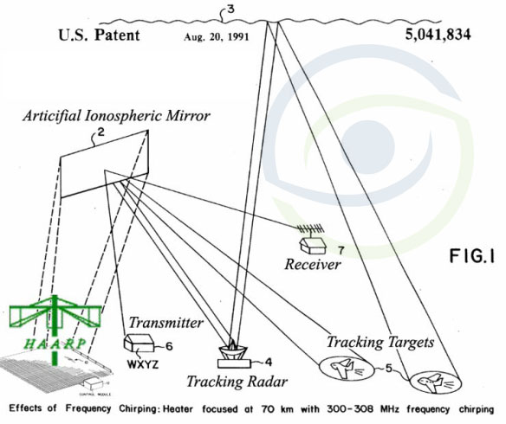
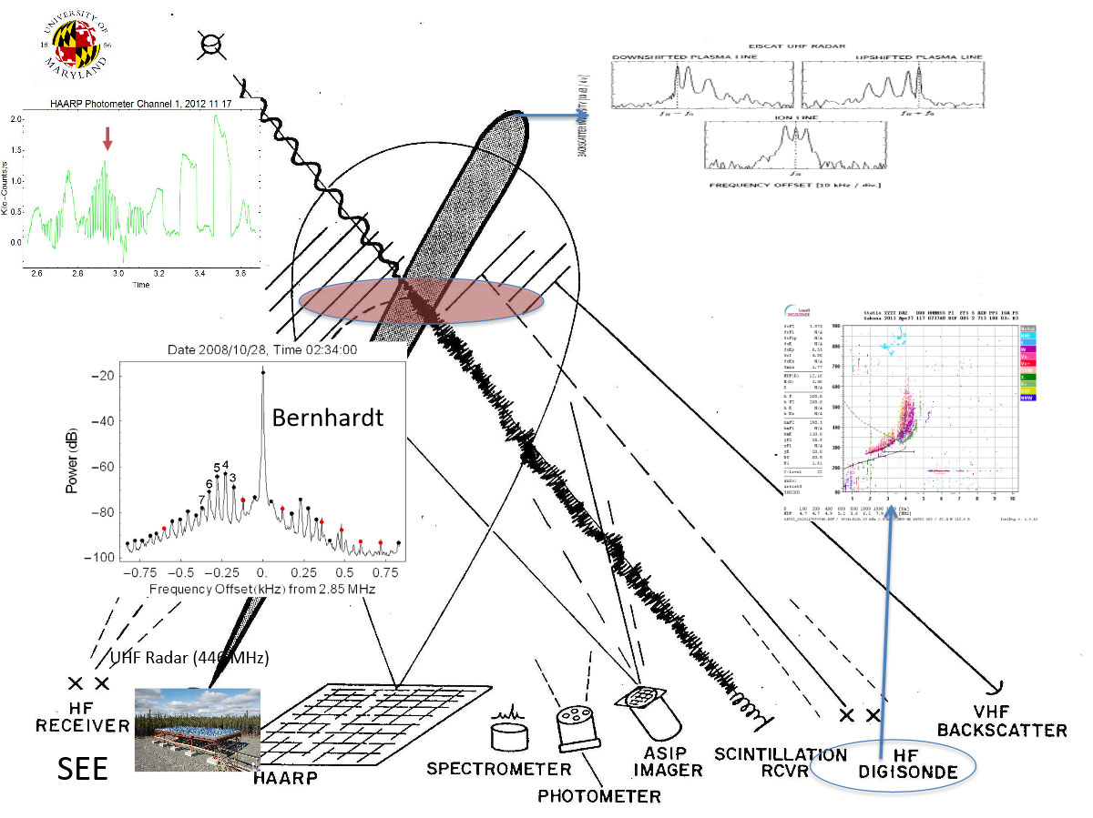
Creating Artificial Ionospheric Mirrors
Heating Plasma to Reflect Radio Signals
This invention relates to generation of a Artificial Ionospheric Mirror (AIM), or a plasma layer in the atmosphere. The AIM is used like the ionosphere to reflect RF energy over great distances. A tiltable AIM is created by a heater antenna controlled in phase and frequency. The heater antenna phase shift scans a beam to paint a plasma layer. Frequency is changed to refocus at continually higher altitudes to tilt the plasma layer.
PATENT OWNED BY:
BAE SYSTEMS
Notes:
Artificial ionospheric mirror composed of a plasma layer which can be tilted - Current Assignee BAE Systems Information and Electronic Systems Integration Inc
https://patents.google.com/patent/US5041834A/en
http://spp.astro.umd.edu/SpaceWebProj/Invited%20Talks/Active%20Experiments-2013.pdf - Using Active Experiments to Probe Geospace, Dennis Papadopoulos, University of Maryland

Slide 43
Creating Artificial Ionospheric Mirrors
Laser Developed Atmospheric Lens (LDAL)
THE FUTURE OF SPYING Earth’s atmosphere can be turned into massive surveillance system using LASERS, scientists discover
British firm unveils research which shows that the atmosphere could be used to spy on ordinary citizens in unprecedented detail.
TECHNOLOGY OWNED BY BAE SYSTEMS
Notes:
https://climateviewer.com/2017/01/16/bae-systems-laser-developed-atmospheric-lens-is-haarp-tech-re-branded/
BAE Systems' Laser Developed Atmospheric Lens is HAARP Tech Re-branded 01/16/2017
https://www.youtube.com/watch?v=PG2lZJSxzr8
BAE Systems - Laser Developed Atmospheric Lens Force Shield Unveiled Combat Simulation
https://www.youtube.com/watch?v=j0JR_L_VY8Y

Slide 44
Creating Artificial Ionospheric Mirrors
Laser Developed Atmospheric Lens (LDAL)
Notes:
https://climateviewer.com/2017/01/16/bae-systems-laser-developed-atmospheric-lens-is-haarp-tech-re-branded/
BAE Systems' Laser Developed Atmospheric Lens is HAARP Tech Re-branded 01/16/2017
https://www.youtube.com/watch?v=PG2lZJSxzr8
BAE Systems - Laser Developed Atmospheric Lens Force Shield Unveiled Combat Simulation
https://www.youtube.com/watch?v=j0JR_L_VY8Y

Slide 45
Probing Underground Structures
Non-invasive imaging or underground structure is important for the detection of hidden tunnels and other hazards, as well as resource exploration, mineral exploration, and environmental contamination problems.
The HAARP transmitter has the potential to be a valuable exploration tool in that it could generate electromagnetic fields that appeared locally as plane waves and could overcome the problems with low AMT signal levels and geologic noise.
Notes:
http://www.dtic.mil/dtic/tr/fulltext/u2/a398268.pdf
https://www.scribd.com/doc/133762611/Imaging-of-Underground-Structure-Using-HAARP

Slide 46
Probing Underground Structures
Some years ago, military-backed scientists at Alaska's High Frequency Active Auroral Research Program (HAARP) were able to map out tunnels at depths of a hundred feet or greater. Papadopoulos, for example, says he wants to do another round of subterranean surveillance experiments. "Personally, I believe it can reach 1,000 kilometers. It [currently] can't reach Iran, if that's your question," one of those researchers, Dennis Papadopoulos told Danger Room. "But if I put HAARP on a ship, or on an oil platform, who knows?“ – Wired Magazine
Notes:
https://www.wired.com/2010/01/irans-nuclear-molemen/
https://www.wired.com/politics/security/magazine/17-08/mf_haarp

Slide 47
Creating Artificial Earthquakes
“Others are engaging even in an eco-type of terrorism whereby they can alter the climate, set off earthquakes, volcanoes remotely through the use of electromagnetic waves.
So there are plenty of ingenious minds out there that are at work finding ways in which they can wreak terror upon other nations. It's real, and that's the reason why we have to intensify our efforts, and that's why this is so important.”
Secretary of Defense William Cohen speaking at “Terrorism, Weapons of Mass Destruction, and U.S. Strategy”
Sam Nunn Policy Forum - April 28, 1997 University of Georgia, Athens, Georgia
Notes:
Terrorism, Weapons of Mass Destruction, and U.S. Strategy Sam Nunn Policy Forum - April 28, 1997 University of Georgia, Athens, Georgia
http://archive.defense.gov/transcripts/transcript.aspx?TranscriptID=674

Slide 48
Creating Artificial Earthquakes
The Fukushima-Daiichi Meltdown and Magnitude 9 Earthquake
Atmosphere Above Japan Heated Rapidly Before M9 Earthquake
Dimitar Ouzounov at the NASA Goddard Space Flight Centre in Maryland and a few buddies present the data from the Great Tohoku earthquake which devastated Japan on 11 March. Their results, although preliminary, are eye-opening.
They say that before the M9 earthquake, the total electron content of the ionosphere increased dramatically over the epicenter, reaching a maximum three days before the quake struck.
Notes:
Japan Earthquake Was ‘In the Air’ Days Before, Scientist Claims
https://www.livescience.com/14221-earthquake-prediction-atmosphere.html
Atmosphere Above Japan Heated Rapidly Before M9 Earthquake
https://www.technologyreview.com/s/424033/atmosphere-above-japan-heated-rapidly-before-m9-earthquake/
Can electric signals in Earth’s atmosphere predict earthquakes?
http://www.sciencemag.org/news/2015/12/can-electric-signals-earth-s-atmosphere-predict-earthquakes

Slide 49
Creating Artificial Earthquakes
The Fukushima-Daiichi Meltdown and Magnitude 9 Earthquake
HAARP Ionospheric Heater Active During Japan’s Earthquake
This image is from the U.S. Air Force’s induction magnetometer at the HAARP facility in Gakona, AK. It shows a strong 2.5 Hz signal during the magnitude 9 earthquake, and had been on for days leading up to the quake.
Notes:
https://web.archive.org/web/20110315212121/http://www.haarp.alaska.edu:80/haarp/data.html
https://web.archive.org/web/20110610075420/http://www.haarp.alaska.edu/haarp/magind.html
The induction magnetometer detects temporal variation of the geomagnetic field based on Faraday's law of magnetic induction. This instrument, which was provided by the University of Tokyo, is composed of three individual sensors. Each sensor is comprised of a large number of turns of fine copper wire wound around a rod with high magnetic permeability. The sensitivity of each sensor is determined by the effective area of the detection coil, that is, the cross sectional area of each winding, and the number of turns, and by magnetic flux density threading the coil. The magnetic flux density is enhanced by a factor of approximately 1,000 by the high-permeability metal core. The induction magnetometer installed at the HAARP site is designed to detect a signal level of a few picoTesla (pT) at 1 Hz. The over all frequency response of the magnetometer is shaped by Faraday's law at frequencies below 1 Hz and by active filters at frequencies above 1 Hz. Below 1 Hz the coil response is proportional to the time derivative of the magnetic field and thereby gives a response proportional to the frequency. Above 1 Hz, signals are suppressed by a low-pass filter with a corner frequency at 2.5 Hz. The filter response diminishes by 24 dB per octave above the corner frequency and thereby eliminates interference from 60 Hz radiation. The magnetometer sensors are aligned along the magnetic north, magnetic east and vertical directions to form an orthogonal measure of the derivative of the field. The sensor outputs are amplified by 40,000 and sampled at a 10 Hz rate with 16-bit resolution in a full scale of 10 Volts.
Typical signals
Magnetic field variations of interest in this program are those induced by electric currents in the ionosphere. The major signal categories detected by the induction magnetometer are short period magnetic pulsations such as Pc1, Pc2, Pc3, PiB, and PiC in a frequency range above a few tens of milliHertz. Among these, the induction magnetometer most efficiently detects Pc1 waves in the frequency range from 0.1 Hz to 3 Hz. Pc1 signals are the result of ion-cyclotron radiation generated near the equatorial plane of the outer-magnetosphere that make their way to the ionosphere guided by the magnetic lines of force. In addition, signals generated in the atmosphere that are caused by lightning discharges, the Schuman resonances, are also detected and sometimes become strong enough to mask signals from the ionosphere.

Slide 50
Creating Artificial Earthquakes
The Fukushima-Daiichi Meltdown and Magnitude 9 Earthquake
00000.0025:unid/none:unid:N0N - ACTIVE Presumed, but not yet verified as a man-made signal. Detected at various locations worldwide. With amateur equipment, it is not easy to determine eventual frequency shifts, so signal is listed as a 2.5 Hz carrier. So far the signal is not connected with any known geophysical events. Most likely not originating from HAARP - Gakona in Alaska USA. They have little success, with the generation of ELF signals of reasonable strength, over anything then relative short distances. – February 23, 2002
This is the 2.5 Hz Shear Alfven (Ultra-low Frequency) Wave created by HAARP, 2010
Notes:
http://spp.astro.umd.edu/SpaceWebProj/Invited%20Talks/Virtual%20ULF%20Antennea-2013.pdf - “Virtual ULF/ELF/VLF Ionospheric Antennae” Resolving Critcal Radiaton Belt & Geospace Issues, Dennis Papadopoulos, University of Maryland
RADIO-SIGNALS BELOW 10 kHz
http://www.vlf.it/trond2/below10.html
Has not been updated since 2002
http://web.archive.org/web/20020223181817/http://www.vlf.it/trond2/below10.html

Slide 51
Creating Artificial Earthquakes
The Fukushima-Daiichi Meltdown and Magnitude 9 Earthquake
WHICH CAME FIRST?
Did the Earth shifting and fracturing heat the ionosphere before the earthquake?
OR
Did an Ionospheric Heater heat the ionosphere which caused the earthquake?
Notes:
http://spp.astro.umd.edu/SpaceWebProj/Invited%20Talks/Virtual%20ULF%20Antennea-2013.pdf - “Virtual ULF/ELF/VLF Ionospheric Antennae” Resolving Critcal Radiaton Belt & Geospace Issues, Dennis Papadopoulos, University of Maryland
RADIO-SIGNALS BELOW 10 kHz
http://www.vlf.it/trond2/below10.html
Has not been updated since 2002
http://web.archive.org/web/20020223181817/http://www.vlf.it/trond2/below10.html

Slide 52
Project SECEDE Barium Clouds
ENMOD Weather Warfare Ban
Ukraine Burns Hole in Ionosphere (modifies weather)
The Russian Woodpecker and Chernobyl Meltdown
Project Waterhole (interrupting aurora)
Project Cameo Barium Clouds
Stanford Star Lab Ionospheric Modification
Beam Experiment Aboard Rocket (BEAR)
CRRES and the Arecibo Ionospheric Heater
DoD Plans HAARP
Global Weather Control using Ionospheric Modification
Space Based Directed Energy Weapons / Satellites
Military used of ULF and ELF based Mind Control
1950-1970
1970-1990
1990-2020
THE FUTURE
Upper Atmospheric Nuclear Explosions
Project Highwater
Project West Ford (Needles)
Lyndon Johnson on Space Control
Sounding Rockets & Ion Clouds
Project HARP Cannon
Solar Powered Satellite (SPS)
Counterforce Weather Control: SPACECAST 2020
High Frequency Active Auroral Research Program (HAARP)
Test Technology Symposium 1997: Weather Modification
Secretary of Defense William Cohen on Eco-Terrorism
High Voltage Orbiting Long Tether (HiVOLT)
Thunderstorm Solar Power Satellite
Charged Aerosol Release Experiment (CARE)
Project LUCY Transmitters & Noctilucent Clouds
Climate Global Control Trading LLC
The United States of America’s Space Force

Slide 53
Learn More
1800
1946
2025
Welcome to Weather Modification History (WMH), the world’s most comprehensive weather control archive with hundreds of verified historical facts, images, and videos. WMH’s compelling evidence is easy to browse, exceedingly accurate, and encyclopedic in scope. This website was crafted by dedicated individuals to help you discern fact from fiction with meticulously organized research that offers the activist community a credible compendium.
Weather Modification History was created to inform the public of the extensive history of weather modification experiments. Our goal is to increase public awareness and debate about the moral and legal implications of today's multi-billion dollar weather control industry and the coming global governance of sunlight-blocking geoengineering schemes. This website will empower you to take action and raise awareness of the little known but lengthy history of weather modification and the men who dare attempt it.
The Star Wars section on Weather Modification History
Also be sure to check out:
HAARP and the Sky Heaters on ClimateViewer News
Articles on Ionospheric Heaters on ClimateViewer News
Atmospheric Sensors & EMF Sites on ClimateViewer 3D

Slide 54
Climateviewer news
Climateviewer 3d
weathermodificationhistory
blog
maP / GLOBE
TIMELINE
POLLUTION: Map polluted locations worldwide, gather facts on those affected, and use those facts to combat polluters’ public relations (PR).
PRIVACY: Raise awareness of technology used to monitor, mock, and silence activists who dare attempt to combat climate change, today.
PROPAGANDA: Educate others on perception management, public relations, and other mass media mind-control techniques used against you, the reader.
ClimateViewer 3D is your source for geophysical monitoring and personal education with live imagery on a gorgeous 3D globe or a mobile-friendly flat map. ClimateViewer features an encyclopedic list of exclusive maps resulting in thousands of hours of personal educational bliss not found anywhere else on the internet, let alone in one place.
The world’s most comprehensive weather control archive with hundreds of verified historical facts, images, and videos. WMH’s compelling evidence is easy to browse, exceedingly accurate, and encyclopedic in scope. This website was crafted by dedicated individuals to help you discern fact from fiction with meticulously organized research that offers the activist community a credible compendium.

Slide 55
Subscribe!
Check out my latest videos on YouTube, Twitch, and Bit.Tube!

Slide 56
PATREON.COM/CLIMATEVIEWER
PAYPAL.ME/CLIMATEVIEWER
GOFUNDME.COM/CLIMATEVIEWER
by @site2max, www.site2max.pro
Notes:
https://www.patreon.com/climateviewer
https://www.paypal.me/climateviewer
https://www.gofundme.com/climateviewer

Slide 57
I am James Franklin Lee Jr. (Jim Lee) and I help people understand complex ideas by creating maps, timelines, articles, and lectures. I am going to talk about Pollution, Privacy and Propaganda every chance I get because they interest me, affect us, and I care about our Planet. ClimateViewer News is my blog and the central location for all of my research.
I am forever a Boy Scout, lifetime artist, nocturnal programmer, music is my life, love is my religion, and I am the luckiest husband and father on Earth. I speak for the trees. I have a passion for mapping, magnets, and mysteries.
I have devoted the last seven years of my life to understanding and reporting the truth about the lengthy history of weather modification. I represented people like myself at the EPA’s hearing on aviation pollution in August 2015, lectured at Ed Griffin’s conference Global Warming: An Inconvenient Lie in December 2016, and my research has been referenced on many prominent websites, including the Comprehensive Nuclear-Test-Ban Treaty Organization (CTBTO), Canadian Geophysical Union, MIT, Harvard, and the United Nations.
about Jim lee
Notes:
Contact Jim Lee
https://climateviewer.com/about/
jim@climateviewer.com
Skype: rezn8d

